Slide 1
DoE Funded Cleanser Compatibility Study with PEM Fuel Cells Final Summary Award Number: DE-EE0000467
W. Collins
2015 November 03

Slide 2
Subtask Objective:
The Center for Clean Energy Engineering (C2E2) at the University of Connecticut is leveraging its expertise and that of its partners to screen commercial off the shelf (COTS) cleansers and degreasers and determine if they are likely to adversely affect PEM fuel cell performance and durability.
The objective of the subtask is simply screening the cleansers selected. Only recover technique to be explored is increasing the dewpoint at the cathode inlet, a simple vehicle in situ method that should be viable at a repair garage

Slide 3
Subtask Background:
Hardware cleanliness has been and remains an issue for fuel cell vehicles. The issue applies to hardware potentially used on the vehicle and as part of the infrastructure. The contaminants on the hardware need to be safely removed; however the agents used to remove the contaminants should not be a source of contamination.
These cleaning agents should be completely removed from the fuel cell systems and the supporting infrastructure. However, by the nature of the designs, this while laudable, might not be viable. Therefore, knowledge on the affect these agents have on PEM fuel cells is needed in selecting an appropriate agent.

Slide 4
Selection of agents:
The approach taken was to conduct a user survey to determine the most commonly used cleansers and to screen them at a concentration appropriate to residual diluted cleanser left in the fuel systems.
The survey consisted with a list originally generated by the fuel cell providers (US Fuel Cell Council) as augmented by input from members of the SAE Fuel Cell Standards Committee. The total input was compiled and down selected based on the compounds listed in the Safety Data Sheets (SDS) for each agent investigated. Over sixty products were reviewed and classified. The classifications selected were “cations”, “organics”, “citrates”, and “amines”.
A second requirement was that the cleaning agents be readily available and cost effective. To address this requirement it was decided that the agents be available through a national retail source: McMaster-Carr, Grainger, Home Depot, Lowes, True Value and/or several supermarket chains which carry national brands (e.g. Procter & Gamble, Colgate Palmolive).

Slide 5
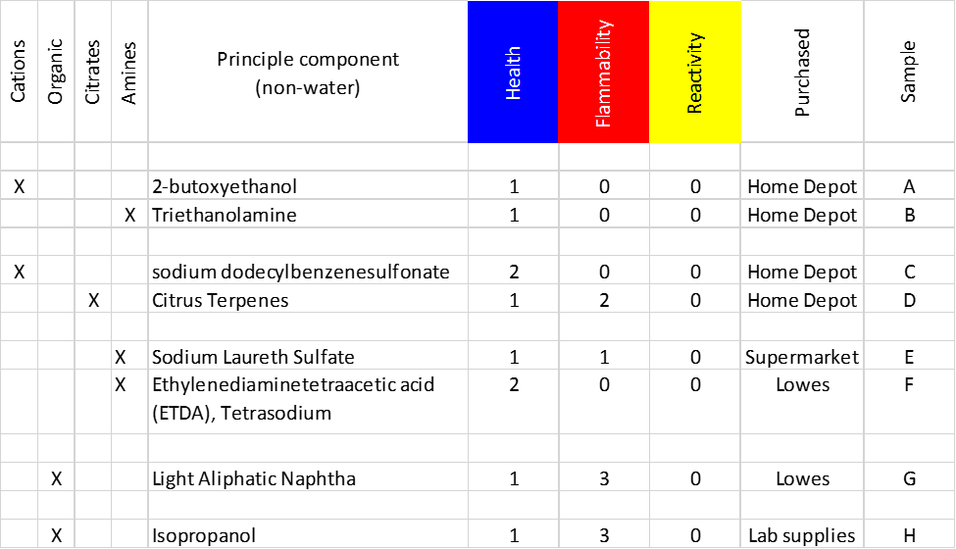
Selection of agents (cont.):

Slide 6
Selection of agents (cont.):
A third requirement was to avoid an agent that is restricted or is most likely restricted by the authorities having jurisdiction (e.g. US EPA, US FDA, European Directive (e.g. REACH).
A fourth requirement was safety to the researchers, which are students. This was done by review of the NFPA 704 ratings noted in the SDS on each candidate product. Particularly harmful agents were avoided.
A fifth requirement was limited funding.

Slide 7
Selection of agents (cont.):
Based on these requirements, a down select of twelve (12) candidate agents was generated. C2E2 has agreed to test a minimum of six (6) agents. Eight (8) were tested and being reported upon in this document. The final list is noted above.
Brand names are not referred to in this documents to avoid issues with the manufacturers. Commodities are referred to by common usage names.

Slide 8
The Situation to be approximated:
Selected agent concentration models 5% of the manufactures suggested full strength. The 5% is an estimate of the concentration after two quick rinses (typical field cleaning). This translates into an ingested amount of about 14 cm³ of 100% cleanser during a 7 kg fill. Assuming the vehicle averages ¼ power (1000 mA/cm²), the estimate fuel consumption rate for 7 kg is about 14 hours.
Electrode selection:
The test cells were built with 25 cm² Gore-50 (PRIMEA) electrode with 0.4/0.4 mg Pt/cm² catalyst loadings. This selection matches the current and previous US DoE funded research on fuel and air contaminant.

Slide 9
Test Conditions:
It was decided that the PEM test cells would be run at 1000 mA/cm² at 80oC with a relative humidity of ~25% on the anode and ~125% on the cathode. The reactant flows were run at a stoichiometry of 10 for the anode and 4 for the cathode flow, to avoid secondary effects. The exit pressures were balanced at ambient. The conditions are designed to maximize the contaminant transport from the cathode to the anode to emulate the worst case scenario.
The miscible agents with low vapor pressures were diluted with DI-water and injected with a nebulizer (hardware used for the non-gaseous air impurities testing. Immiscible and/or high vapor pressure agents were directly injected into the air stream and allowed to “flash” (vaporize). Only naphtha and isopropanol were “flash”.

Slide 10
Results:
The two agents selected to represent cations, Samples “A” and “C”, decayed at a moderate rate (~1 to 5 mV/hr) and did not recover in the time frame of a single vehicle fill. This conclusion is based on the performance history, IR measurements and EIS measurements.
Two agents were initially selected to represent citrates. However, one agent was not a citrate but rather had a citrus fragrance. Thus only one citrate was tested, Sample “D”. This cell decayed at a rapid rate (~450 mV/hr) and did not recover in the time frame of a single vehicle fill. The agent was retested in a new cell at a concentration an order of magnitude less. This cell decayed at a slower rate (~20 mV/hr) yet did not recover in the time frame of a single vehicle fill. Again, this conclusion is based on the performance history, IR measurements and EIS measurements.

Slide 11
Results (cont):
The three agents selected to represent amine, Samples “B”, “E” and “F”. Samples “B” and “E” decayed at a moderately fast rate (~10 to 25 mV/hr) and only partially recover in the time frame of a single vehicle fill.
The decay fell below the power electronics low end operating point (assumed to be 50% of idle voltage, or 450 mV/cell). This value is approximate to that mentioned in the October 2015 “All Tech Team Meeting” for the power electronics. The anemic recovery would be inadequate to operate the vehicle.
The third anime, sample “F”, had a slower decay but no recovery. The performance loss more closely followed that of the cations. The SDS for this agent was sketchy at best and identified less than 10% of the composition. This agent may have been misclassified due to lack of definition.

Slide 12
Results (cont):
The last two agents are organics. They were selected because they are currently in use cleaning fielded hydrogen fueling equipment. These agents, naphtha and isopropanol, have high vapor pressures. The data on naphtha appears to result in recovery. Exposure in the 3% by volume area (~250 ul/min) results in a step change below the power electronics low end operating point, however 1% might be tolerated assuming the composition of the naphtha is the same as was tested. Reviewing several SDS for different manufacturers indicate a wide variation in possible composition and the possibility of inclusion of sulfur in the % levels.

Slide 13
Results (cont):
Isopropanol was also evaluated. Low concentrations (0.2% by volume, ~10ul/min) resulted in performance issues severe enough to indicate that further testing would not be cost effective. Subsequent ex-situ testing at above 5% resulted in dissolution of the bond between the cell catalyst layer and the membrane.
The data is supplied under 4 separate covers, two were previously supplied to SAE. All are available upon request.

Slide 14
Conclusion:
While the agents tested do not appear to be compatible with PEMFCs, a number of things were learned during this task which may be helpful.
First, when exposed to several agents the cell responded with step changes in performance. This was not a mechanism study, purely screening, however, it was postulated that this might be due to the agent(s) either changing the local hydrophobicity of the gas diffusion layers (GDL) or localized cooling due to the agent(s) not being completely vaporized. While interesting, running this to ground might not be cost effective.
Second, the information that US Department of Labor OSHA requires in safety data sheets (SDS) is woefully inadequate to be used to determine and quantify the composition of a cleanser.

Slide 15
Conclusion (conc):
Third, the composition of most commercially available cleansers changes frequently. How often have you heard of the “new and improved Tide”? These changes are driven by cost, availability, regulatory changes (e.g. the EPA and Phosphates), product improvements and possibly regional variation (e.g. “soft” versus “hard” water).
Finally, short of developing a cleanser for this specific task, the chances of finding a “silver bullet” is remote. A better tack might be to insure that the cleanser is properly removed from the system prior to use. Cleansers are another system cleanliness concern.

Slide 16
Thank you
Jean St-Pierre
Hawaii Natural Energy Institute
University of Hawaii - Manoa
Honolulu, HI 96822
(808) 956-3909
jsp7@hawaii.edu
Ugur Pasaogullari
Center for Clean Energy Engineering
University of Connecticut
Storrs, CT
(860) 486-2332
ugurpasa@engr.uconn.edu

