Slide 1
DoE Cleanser Screening Tests First Cleanser using 2-butoxyethanol Preliminary
W. Collins
C2E2
2014 September 23

Slide 2
Objective
The objective of this screening test is to conduct a compatibility test between this compound and PEM fuel cells.
The testing is done in support of a supplement to a US DoE EERE contact, DE-EE0000467.
The results indicate some interaction between the compound and PEM fuel cells at the concentration and flow tested.

Slide 3
Test parameters
Cell
Size 25 cm2
Electrode Gore-50
Loadings 0.4/0.4 mgPt/cm2
Operation
Current Density 1000 mA/cm2
Cell Temperature 80⁰C
Inlet dew points
Anode 48⁰C
Cathode 87⁰C
Exit Pressures Ambient/Ambient

Slide 4
Test parameters (cont)
Conditions
Flows
Anode 1.75 lpm (10)
Cathode 1.55 lpm (4)
Atomizer 130e-06 lpm
(~200 ppm)
Operating Point
Intentionally close to flooding
(worst case)
Program
Break in 16 hr hold @600 mV Diagnostics 4 hrs
Baseline 25 hr hold @1000 mA/cm2 Diagnostics 1 hr
Contamination 115 hrs
Diagnostics 1 hr
Clean up 17 hrs
Diagnostics 3 hr
Total 182 hrs

Slide 5
Compound
Concentration 5% of full strength
(estimate after two rinses)
Composition MSDS
Ingredient | CAS Number | Percent Range
Water | 7732-18-5 | > 78%
2-butoxyethanol | 111-76-2 | < 5%
Ethoxylated Alcohol | 68439-46-3 | < 5%
Tetrapotassium Pyrophosphate | 7320-34-5 | < 5%
Sodium Citrate | 68-04-2 | < 5%
Fragrance | Proprietary Mixture | < 1%
Colorant | Proprietary Mixture | < 1%

Slide 6
Results
Summary of Testing
Break in and initial diagnostics normal
Shutdown interruption during baseline
Diagnostics after baseline normal
Steady no recoverable decay during contamination
Diagnostics after contamination abnormal
No recovery

Slide 7
Results (cont)
Test Results of cell HI079:
Figure 1 shows the performance history.
Figure 2 shows no change in IR until attempting clean up.
Figure 3A (anode) and Figure 3C (cathode) show no decay due to crossover.
Figure 4A (anode) and Figure 4C (cathode) show no catalyst issues
However, the Electrochemical impedance spectroscopy (EIS) shown in Figure 5 is very interesting

Slide 8
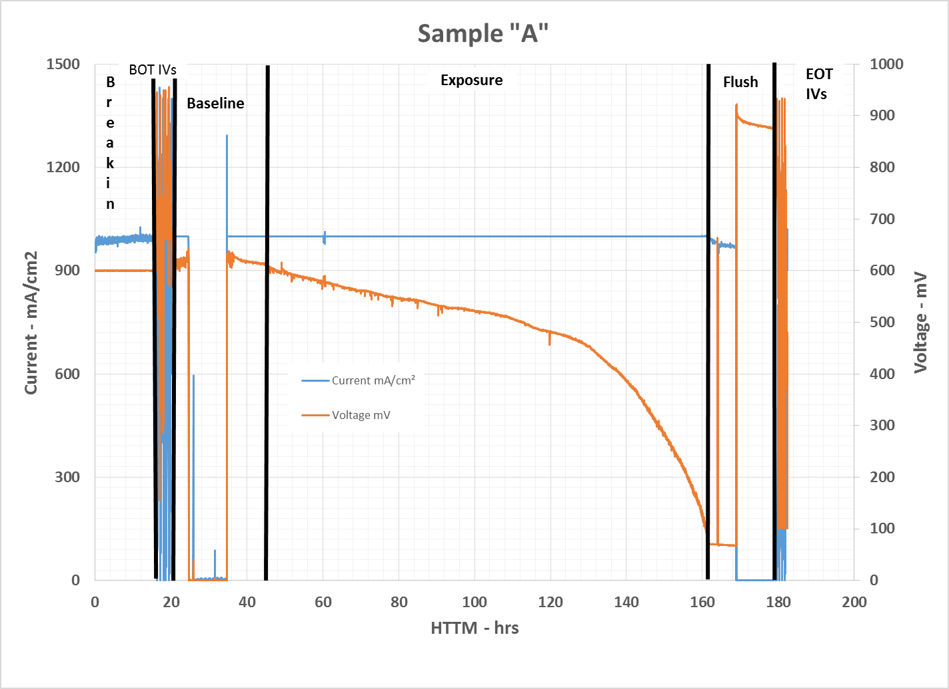
Results (cont)
Figure 1 – Performance History
Decay starts upon exposure.
Open circuit effected.
Interrupt during base to be explored.

Slide 9
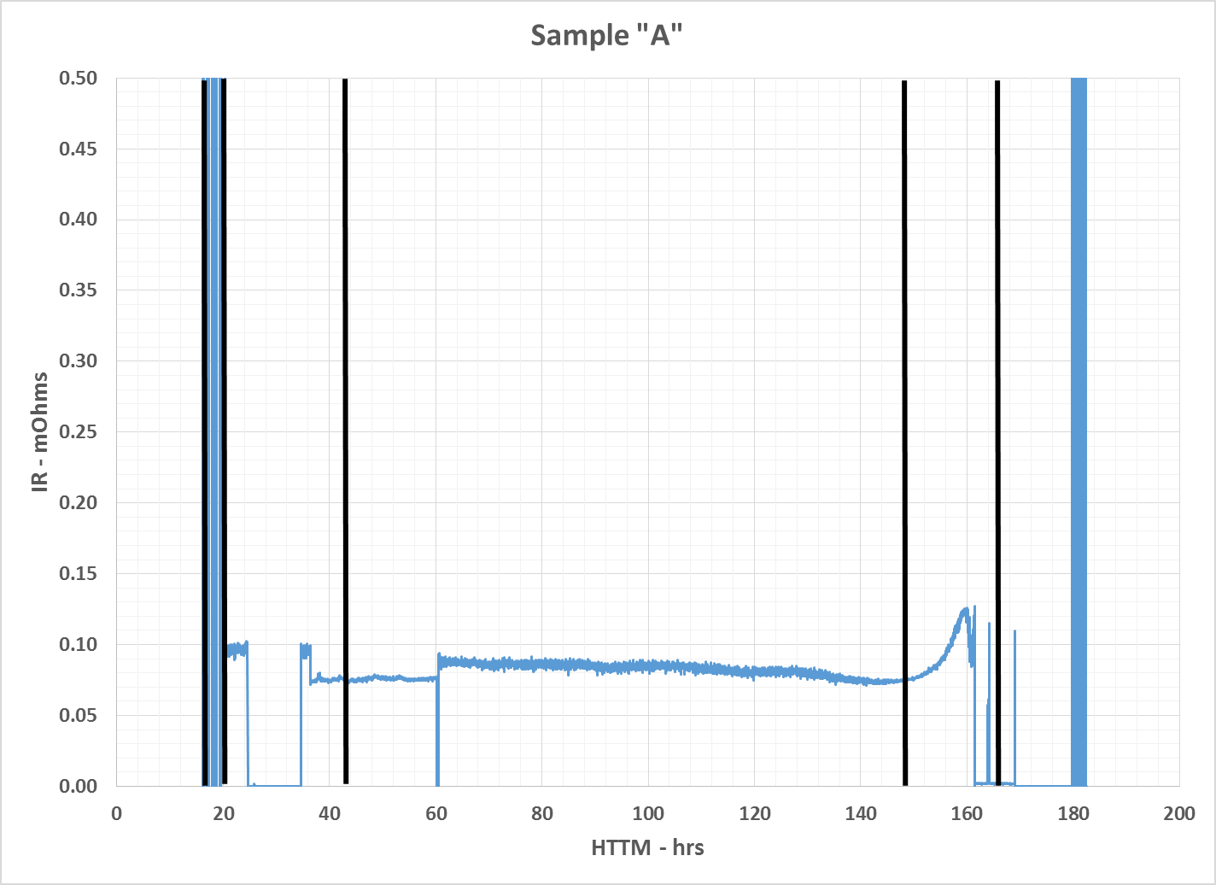
Results (cont)
Figure 2 – IR History
IR has two small step changes.
Generally unaffected during exposure.
Ramp up during clean-up (DI water) to be explored.

Slide 10
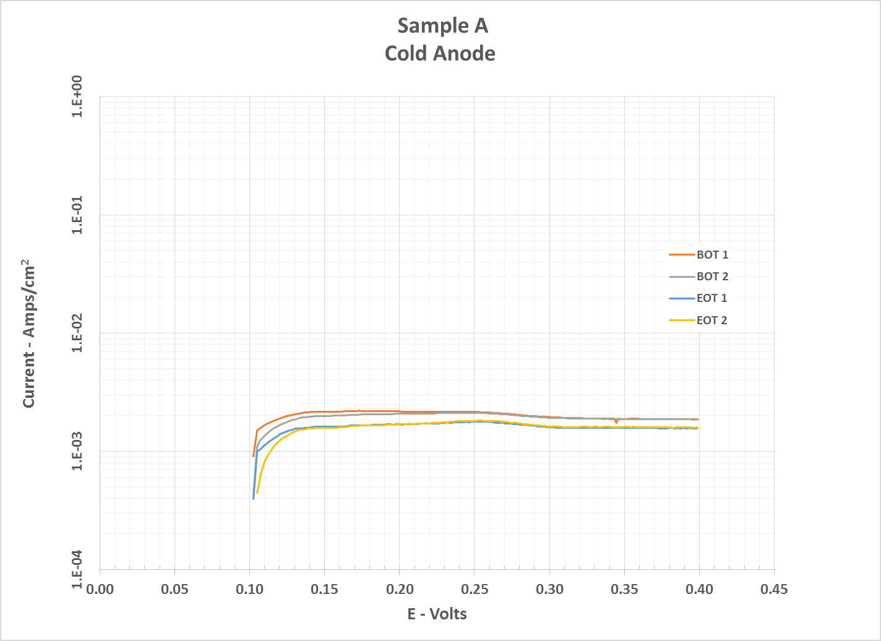
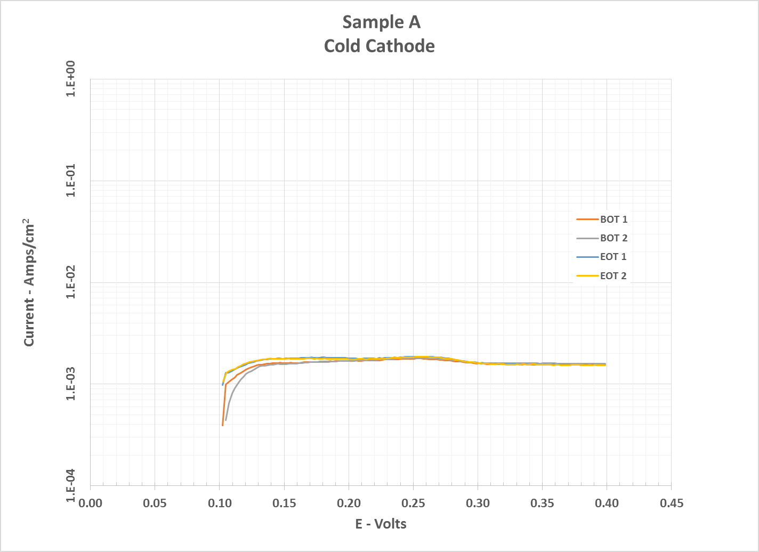
Results (cont)
Figure 3 – X/O History
Beginning of Test and End of Test data basically the same.

Slide 11
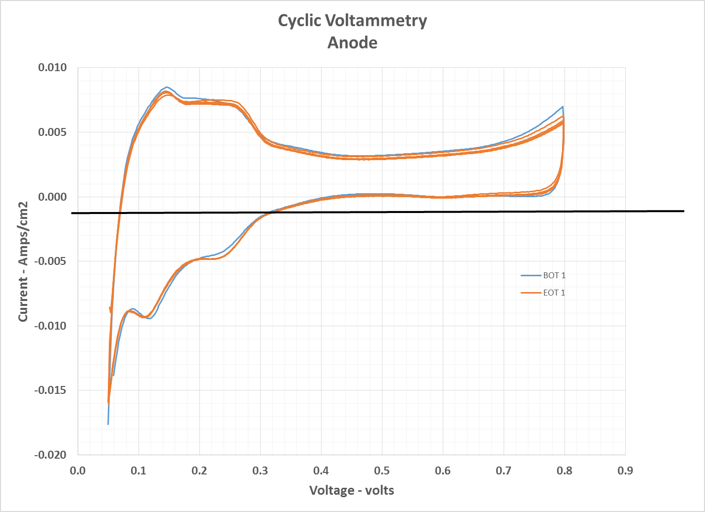
Results (cont)
Figure 4 – Cyclic Voltammetry History
Beginning of Test and End of Test data basically the same.

Slide 12
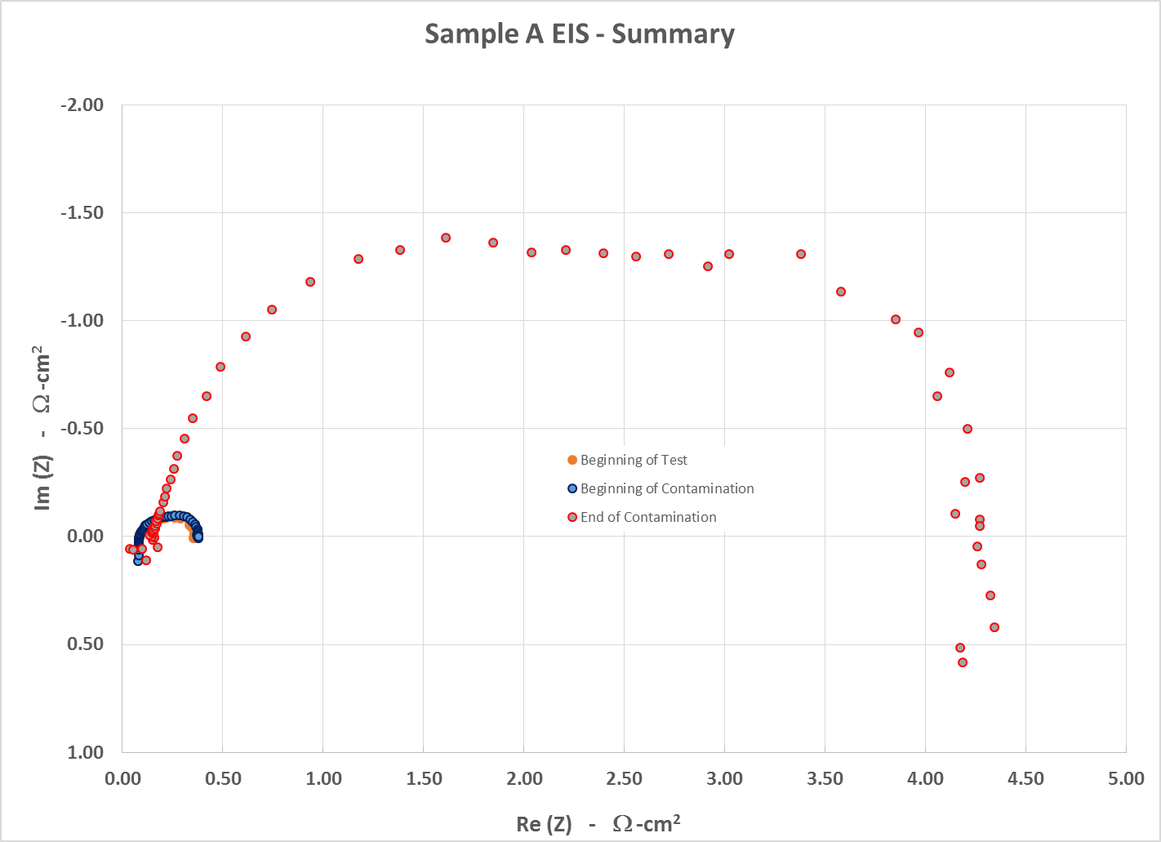
Results (cont)
Figure 5 – Electrochemical impedance spectroscopy (EIS)

Slide 13
Results (cont)
Test Results (cont):
The difference between the measurements at the beginning of the test and beginning of contamination are negotiable.
However, the difference between the measurements at the beginning of contamination and end of contamination are not.
Frequency magnitude from right to left.
Right is 0.1 Hz and represents issues in mass transport issues
Left is 10 kHz and represents ionic and ohmic resistance
Looks to be mass transport issues.

Slide 14
Next Step
Run second cell (HI080)
Condition
Break in
Contaminate for ~15 hours
Clean up for ~30 hours (DI water flush)

Slide 15
What does this mean?
Assumptions:
Ingest 14 cc’s of 100% cleanser during a 7 kg fill
Operate at ~1/4 power (1000 mA/cm2) for 14 hrs (est. range on 7 kg)
Results:
Operating at extreme conditions
Assumptions may be too conservative
Decay is <1.4 mV/hr or <20 mV @1000 mA/cm2
Clean up consisted of injecting DI water. There was a marked recovery to about pre-contamination levels.
However, the EIS did not improve. This may indicate some residual damage.

Slide 16
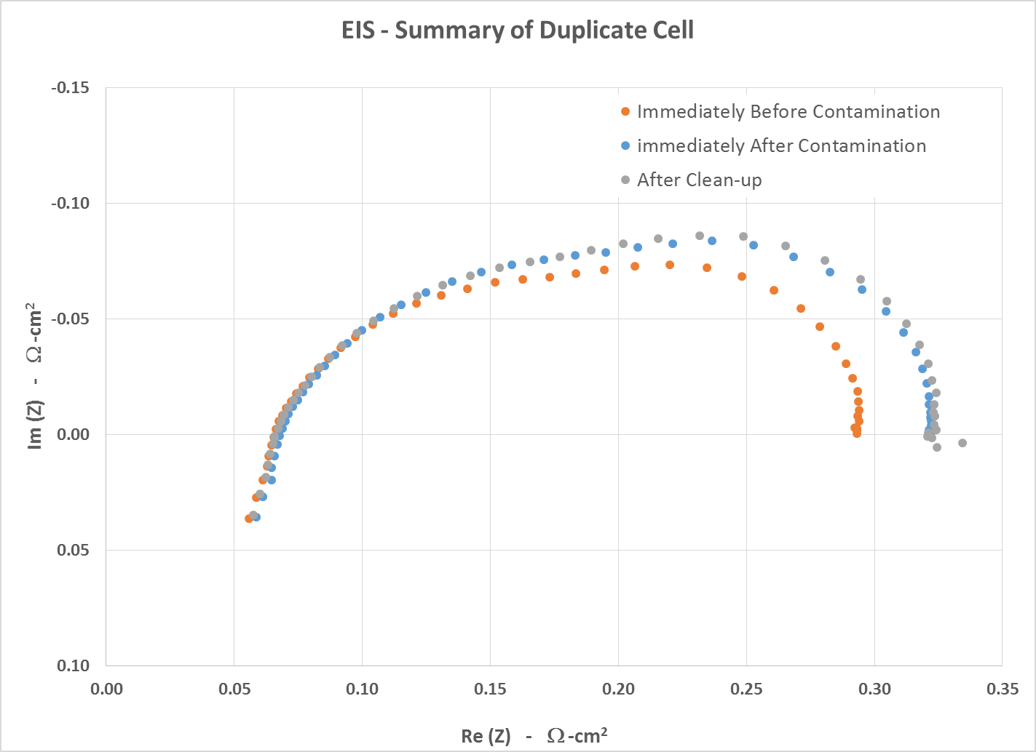
Results (cont)
Figure 6 – Electrochemical impedance spectroscopy (EIS) of duplicate cell
Note: Scales are different between figures 5 & 6

