Slide 1
DoE Cleanser Screening Tests First Cleanser using Sodium Dodecylbenzenesulfonate Preliminary
W. Collins
C2E2
2014 October 22

Slide 2
Objective
The objective of this screening test is to conduct a compatibility test between this compound and PEM fuel cells.
The testing is done in support of a supplement to a US DoE EERE contact, DE-EE0000467.
The results indicate some interaction between the compound and PEM fuel cells at the concentration and flow tested.

Slide 3
Test parameters
Cell
Size 25 cm²
Electrode Gore-50
Loadings 0.4/0.4 mgPt/cm²
Operation
Current Density 1000 mA/cm²
Cell Temperature 80⁰C
Inlet dew points
Anode 48⁰C
Cathode 87⁰C
Exit Pressures Ambient/Ambient

Slide 4
Test parameters (cont)
Conditions
Flows
Anode 1.75 lpm (10)
Cathode 1.55 lpm (4)
Atomizer 130e-06 lpm
(~200 ppm)
Operating Point
Intentionally close to flooding
(worst case)
Program
Break in 20 hr hold @600 mV Diagnostics 6 hrs
Baseline 36 hr hold @1000 mA/cm2 Diagnostics 1 hr
Contamination 23 hrs
Diagnostics 1 hr
Clean up 26 hrs
Diagnostics 6 hr
Total 121 hrs

Slide 5
Compound
Concentration 5% of full strength
(estimate after two rinses)
Composition MSDS
Ingredient | CAS Number | Percent Range
Sodium Dodecylbenzenesulfonate | 25155-30-0 | 1 - 5%

Slide 6
Results
Summary of Testing
Break in and initial diagnostics normal
Baseline normal
Diagnostics after baseline normal
Step change then steady rapid decay during contamination
Diagnostics after contamination abnormal
Continued decay during recovery time at about ½ the decay rate
Diagnostics after clean up show limited improvement

Slide 7
Results (cont)
Test Results:
Figure 1 shows the performance history.
Figure 2 shows no change in IR until attempting clean up.
Figure 3A (anode) and Figure 3C (cathode) show no decay due to crossover.
Figure 4A (anode) and Figure 4C (cathode) show no catalyst issues
However, the Electrochemical impedance spectroscopy (EIS) shown in Figure 5 is very interesting

Slide 8
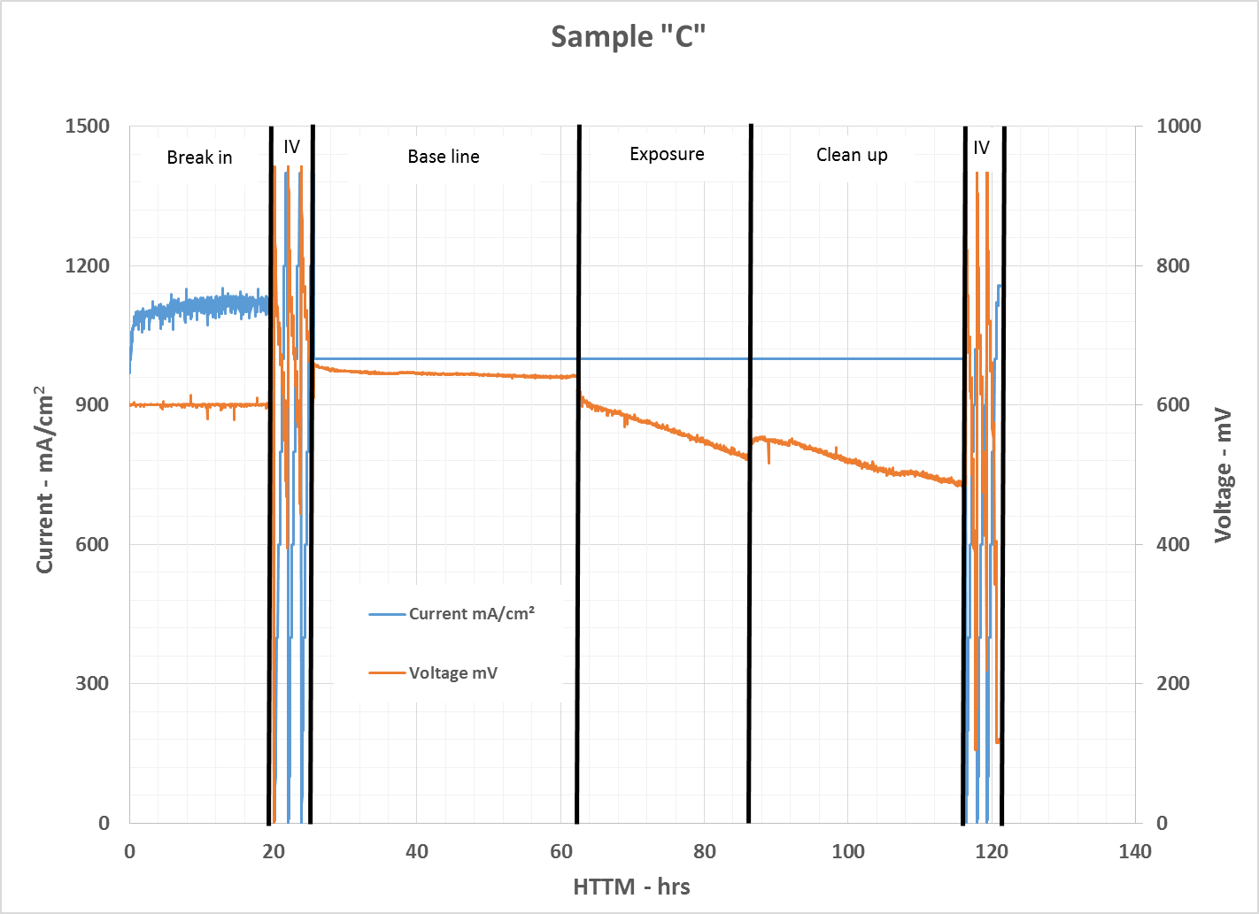
Results (cont)
Figure 1 – Performance History
Rapid decay starts upon exposure.
Linear decrease during exposure.
Decay continues during clean up on DI water

Slide 9
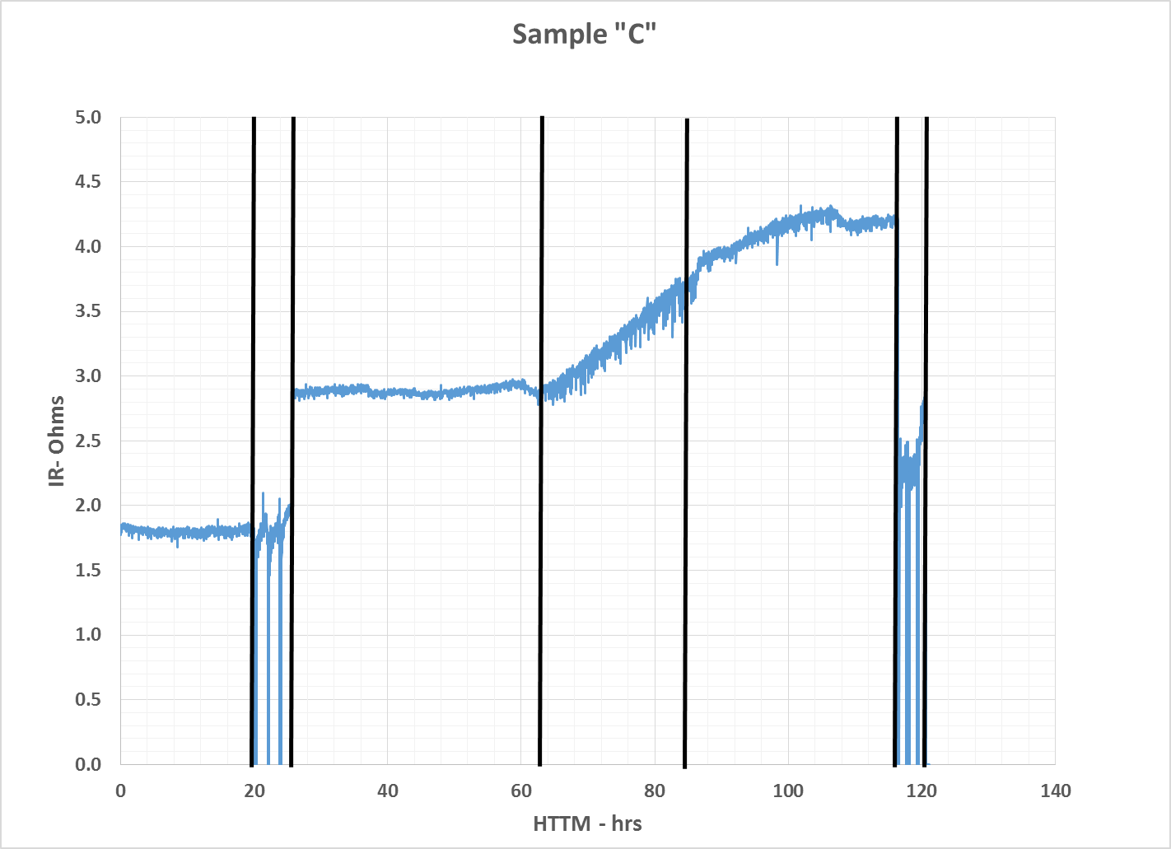
Results (cont)
Figure 2 – IR History
Initial step change due to intentional ‘flooding’.
Linear increase during exposure.
Increase continues during clean up

Slide 10
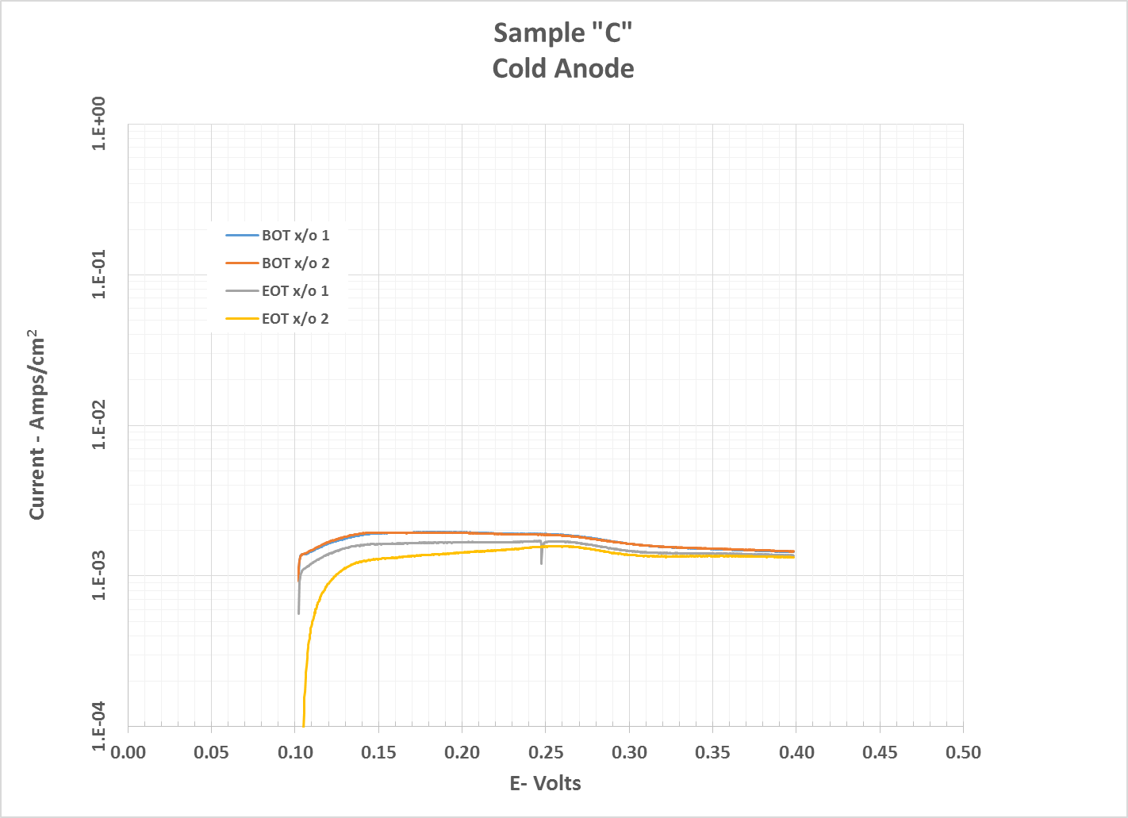
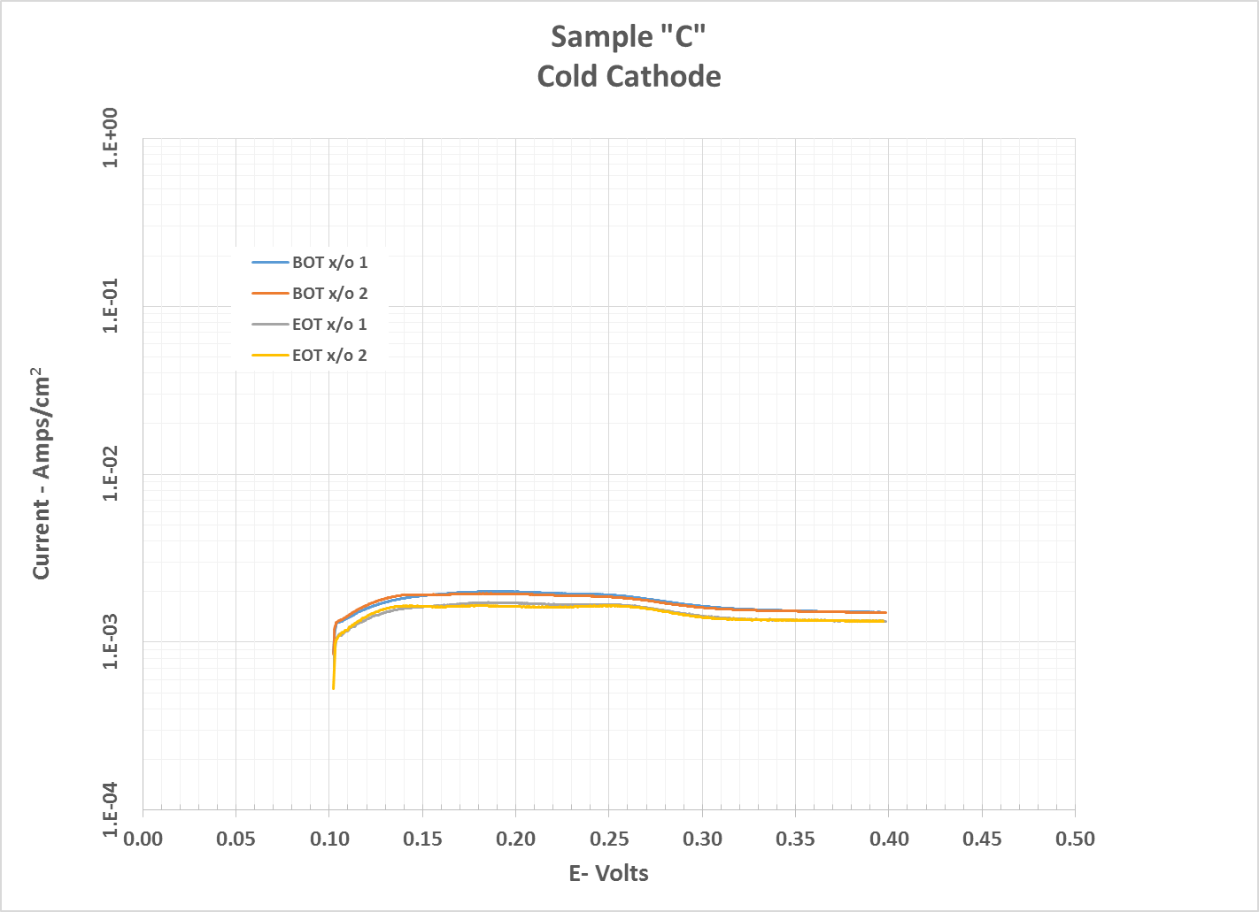
Results (cont)
Figure 3 – X/O History
Beginning of Test and End of Test data basically the same.

Slide 11
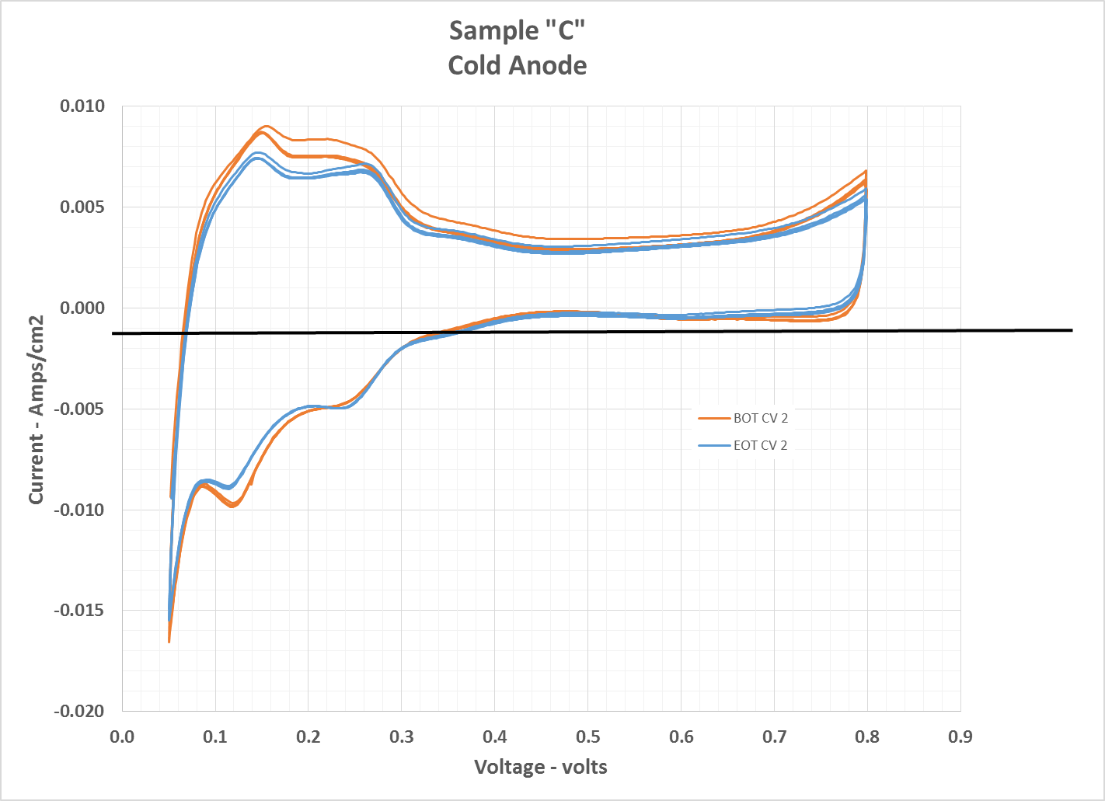
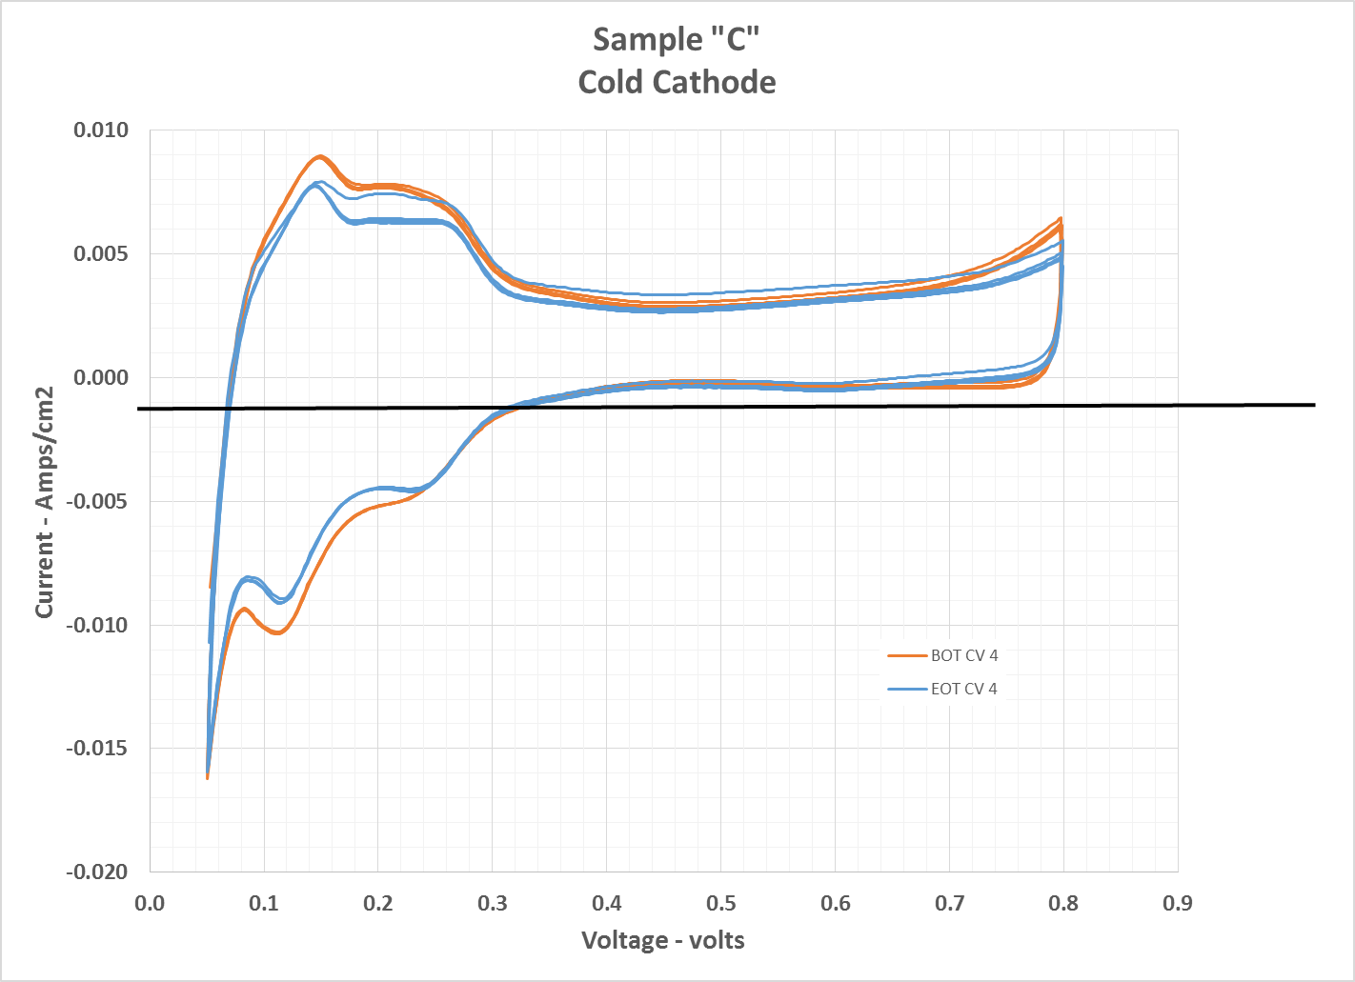
Results (cont)
Figure 4 – Cyclic Voltammetry History
Beginning of Test and End of Test data basically the same.

Slide 12
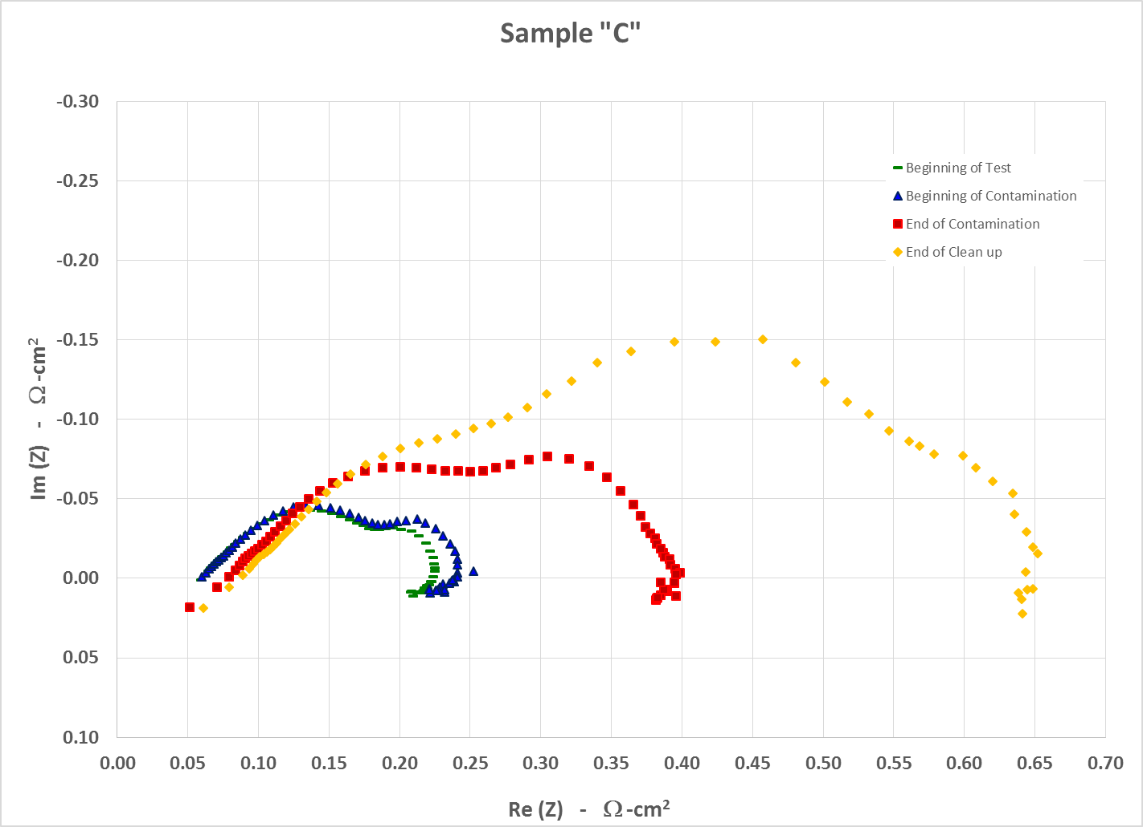
Results (cont)
Figure 5 – Electrochemical impedance spectroscopy (EIS)

Slide 13
Results (cont)
Test Results (cont):
The difference between the measurements at the beginning of the test and beginning of contamination are slight and may be due to saturation of the cathode GDL.
The difference between the measurements at the beginning of contamination and end of contamination are notable.
Frequency magnitude from right to left.
Right is 0.1 Hz and represents issues in mass transport issues
Left is 10 kHz and represents ionic and ohmic resistance
Looks to be mass transport issues.
The difference between the measurements at the end of contamination and end of test are also notable. They mirror the additional decay.

Slide 14
What does this mean?
Assumptions:
Ingest 14 cc’s of 100% cleanser during a 7 kg fill
Operate at ~1/4 power (1000 mA/cm2) for 14 hrs (est. range on 7 kg)
Results:
Operating at extreme conditions
Assumptions may be too conservative
Decay is 0.1 mV/hr @1000 mA/cm2 prior to contamination
Decay is ~5.1 mV/hr @1000 mA/cm2 during contamination
Clean up consisted of injecting DI water. Decay continued, abet at a slower rate
The EIS also continued to worsen. This may indicates mass transport issues.

