Slide 1
DoE Cleanser Screening Tests First Cleanser using Citrus Terpenes; Citrus, extract Preliminary
W. Collins
C2E2
2015 July 21

Slide 2
Objective
The objective of this screening test is to conduct a compatibility test between this compound and PEM fuel cells.
The testing is done in support of a supplement to a US DoE EERE contact, DE-EE0000467.
The results indicate some interaction between the compound and PEM fuel cells at the concentration and flow tested.

Slide 3
Test parameters
Cell
Size 25 cm²
Electrode Gore-50
Loadings 0.4/0.4 mgPt/cm²
Operation
Current Density 1000 mA/cm²
Cell Temperature 80⁰C
Inlet dew points
Anode 48⁰C
Cathode 87⁰C
Exit Pressures Ambient/Ambient

Slide 4
Test parameters (cont)
Conditions
Flows
Anode 1.75 lpm (10)
Cathode 1.55 lpm (4)
Atomizer 130e-06 lpm
(~200 ppm)
Operating Point
Intentionally close to flooding
(worst case)
Program
Break in 20 hr hold @600 mV Diagnostics 5 hrs
Baseline 39 hr hold @1000 mA/cm2 Diagnostics 1 hr
Contamination 1 hrs
Diagnostics 1 hr
Clean up 22 hrs
Diagnostics 5 hr
Total 94 hrs

Slide 5
Compound
Concentration 5% of full strength
(estimate after two rinses)
Composition MSDS
Ingredient | CAS Number | Percent Range
Citrus Terpenes; Citrus, ext. | 94266-47-4 | 1 - 5
Dipropylene glycol monobutyl ether; Glycol Ether DPnB; 1-(2-butoxy-1-methylethoxy) propan-2-ol | 29911-28-2 | 1 - 5
Diethylene Glycol Butyl Ether; 2-(2-butoxyethoxy)-ethanol | 112-34-5 | 1 - 5
Fatty acids, tall-oil | 61790-12-3 | 1 - 5
Sulfonic acids, C14-16-alkane hydroxy and C14-16-alkene, sodium salts | 68439-57-6 | 1 - 5
Alcohols, C12-16, ethoxylated | 68551-12-2 | 1 - 5

Slide 6
Results
Summary of Testing
Break in and initial diagnostics normal
Baseline normal
Diagnostics after baseline normal
Extremely rapid decay during contamination ~220 mV in 15 min.
Diagnostics after contamination abnormal
Most of voltage recovered in all but 70 mV ~30 hr
Diagnostics after clean up show major improvement

Slide 7
Results (cont)
Test Results:
Figure 1 shows the performance history. Figure 1a enhances contamination time.
Figure 2 shows small change in IR during contamination.
Figure 3A (anode) and Figure 3C (cathode) show no decay due to crossover.
Figure 4A (anode) and Figure 4C (cathode) show no catalyst issues
However, the Electrochemical impedance spectroscopy (EIS) shown in Figure 5 is very interesting

Slide 8
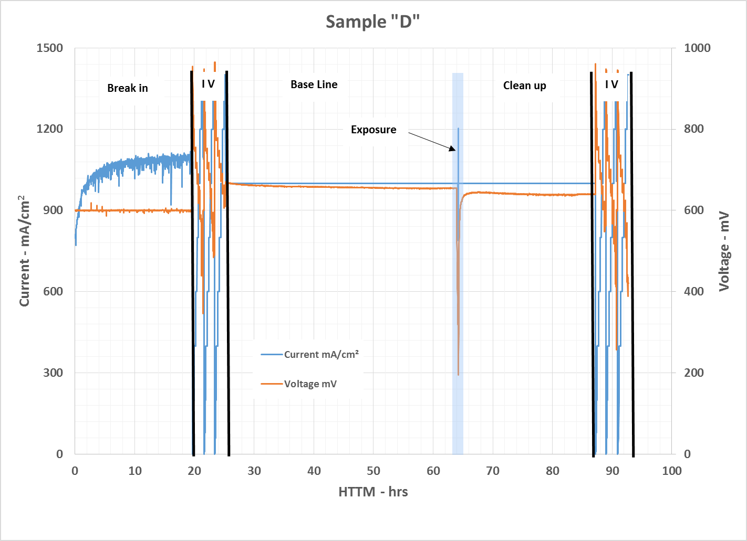
Results (cont)
Figure 1 – Performance History
Precipitous decay starts upon exposure.
Most performance recovered.

Slide 9
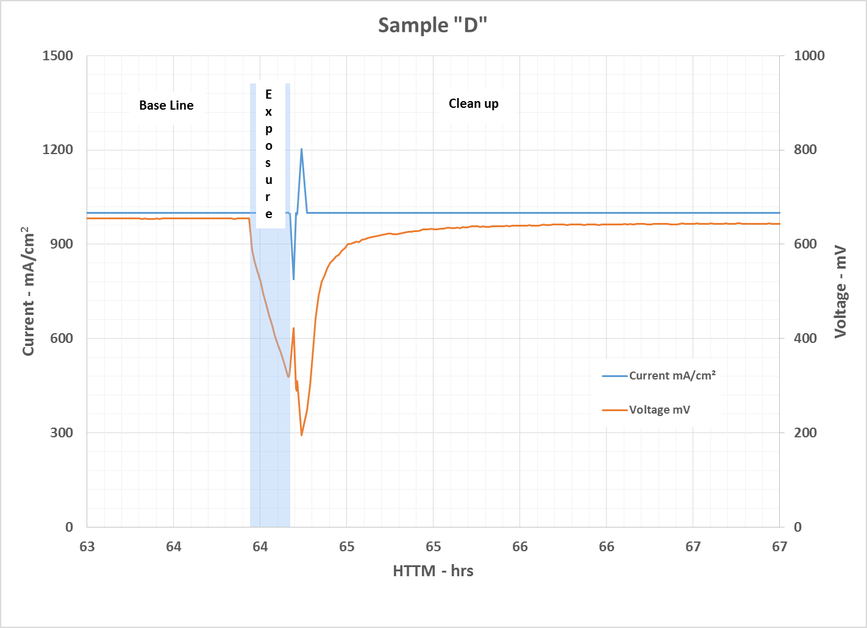
Results (cont)
Figure 1a – Figure 1 with time scale expanded during contamination
Precipitous decay starts upon exposure.
EIS immediately after exposure.

Slide 10
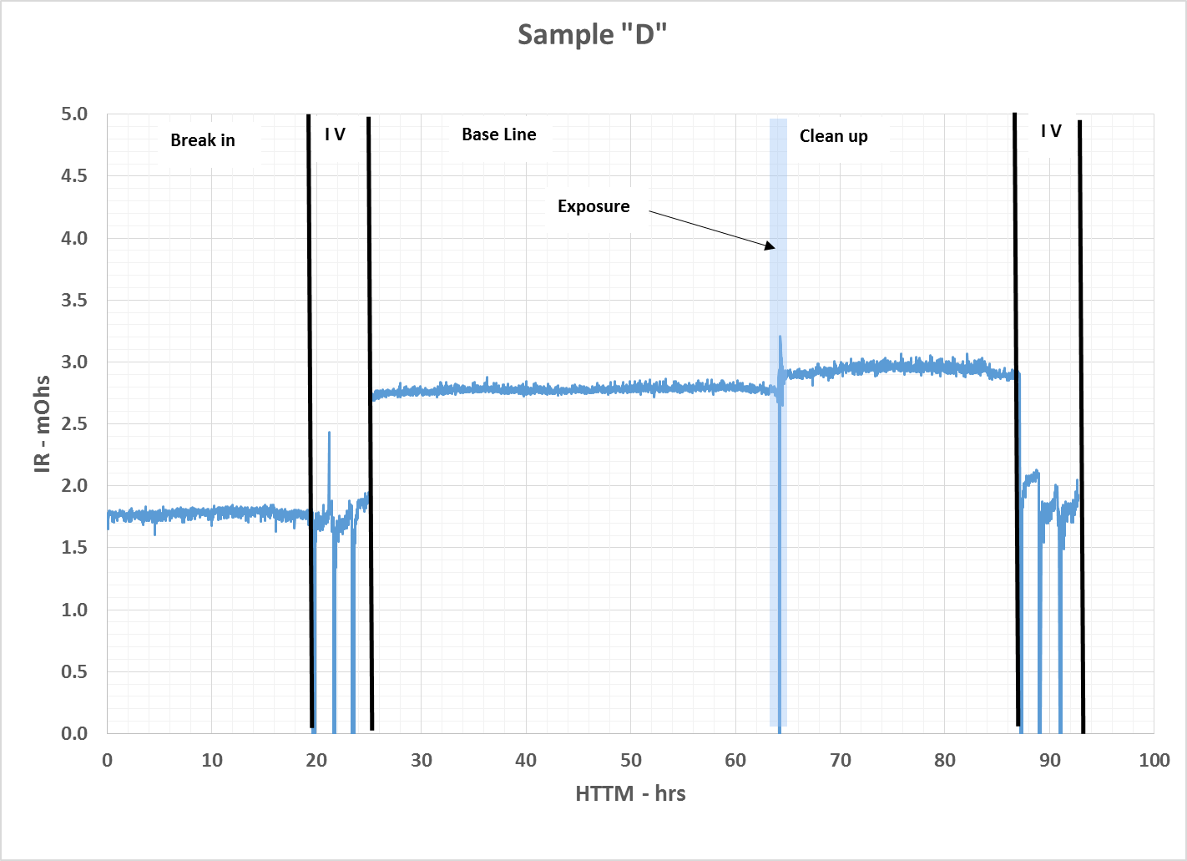
Results (cont)
Figure 2 – IR History
Initial step change due to intentional ‘flooding’.
Increase during exposure.
Stable but elevated during clean up

Slide 11
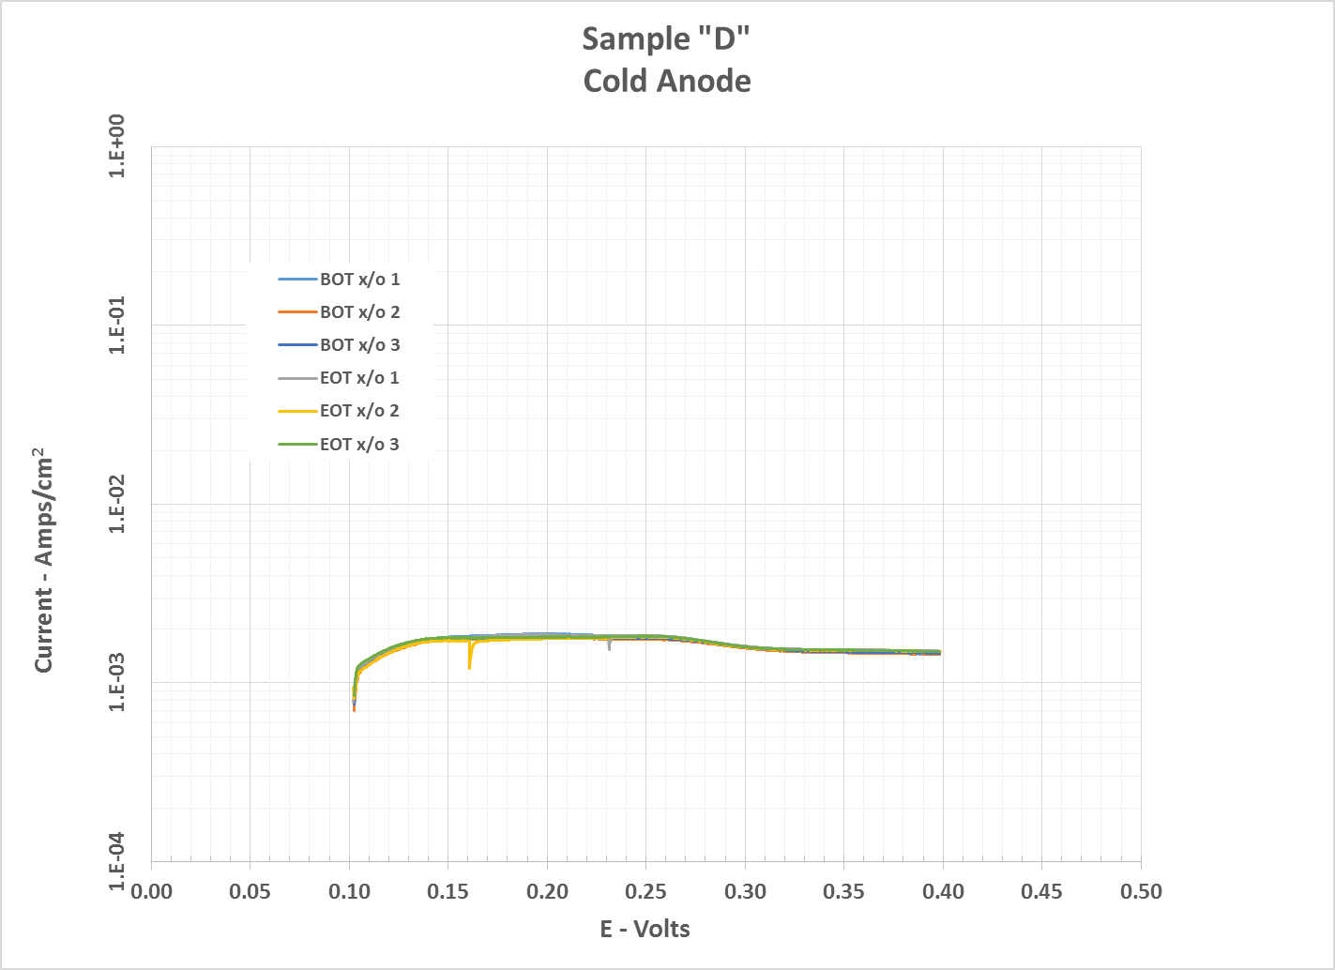
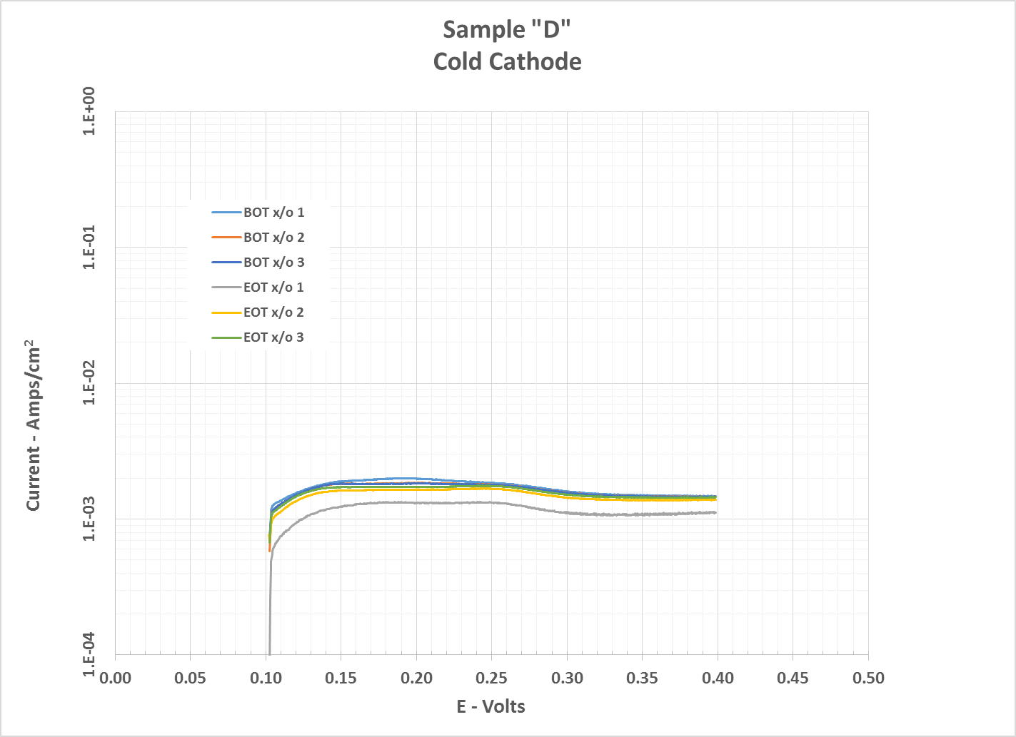
Results (cont)
Figure 3 – X/O History
Beginning of Test and End of Test data basically the same.

Slide 12
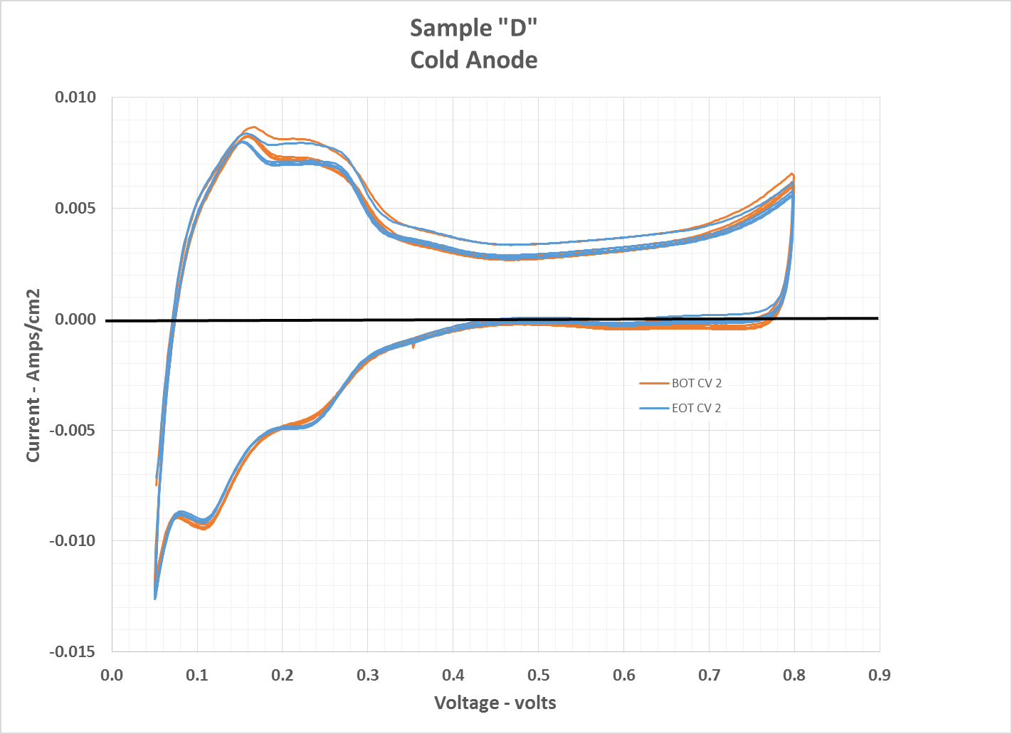
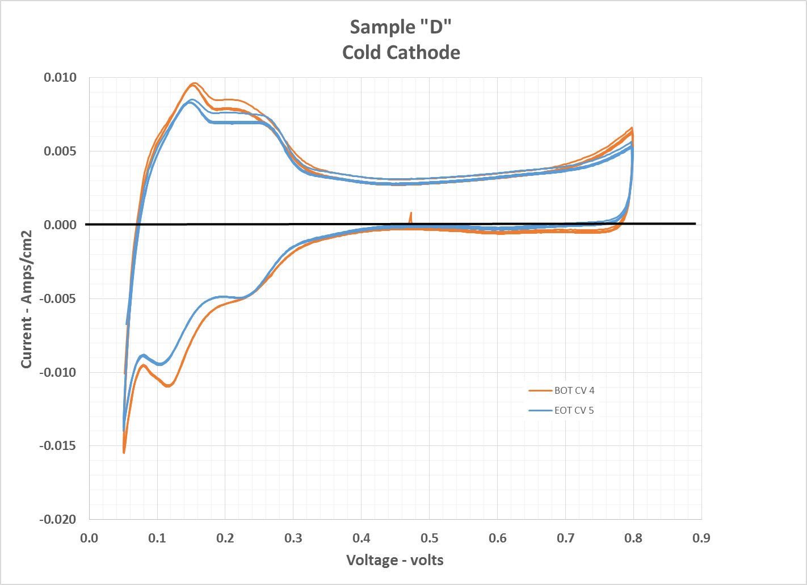
Results (cont)
Figure 4 – Cyclic Voltammetry History
Beginning of Test and End of Test data basically the same.

Slide 13
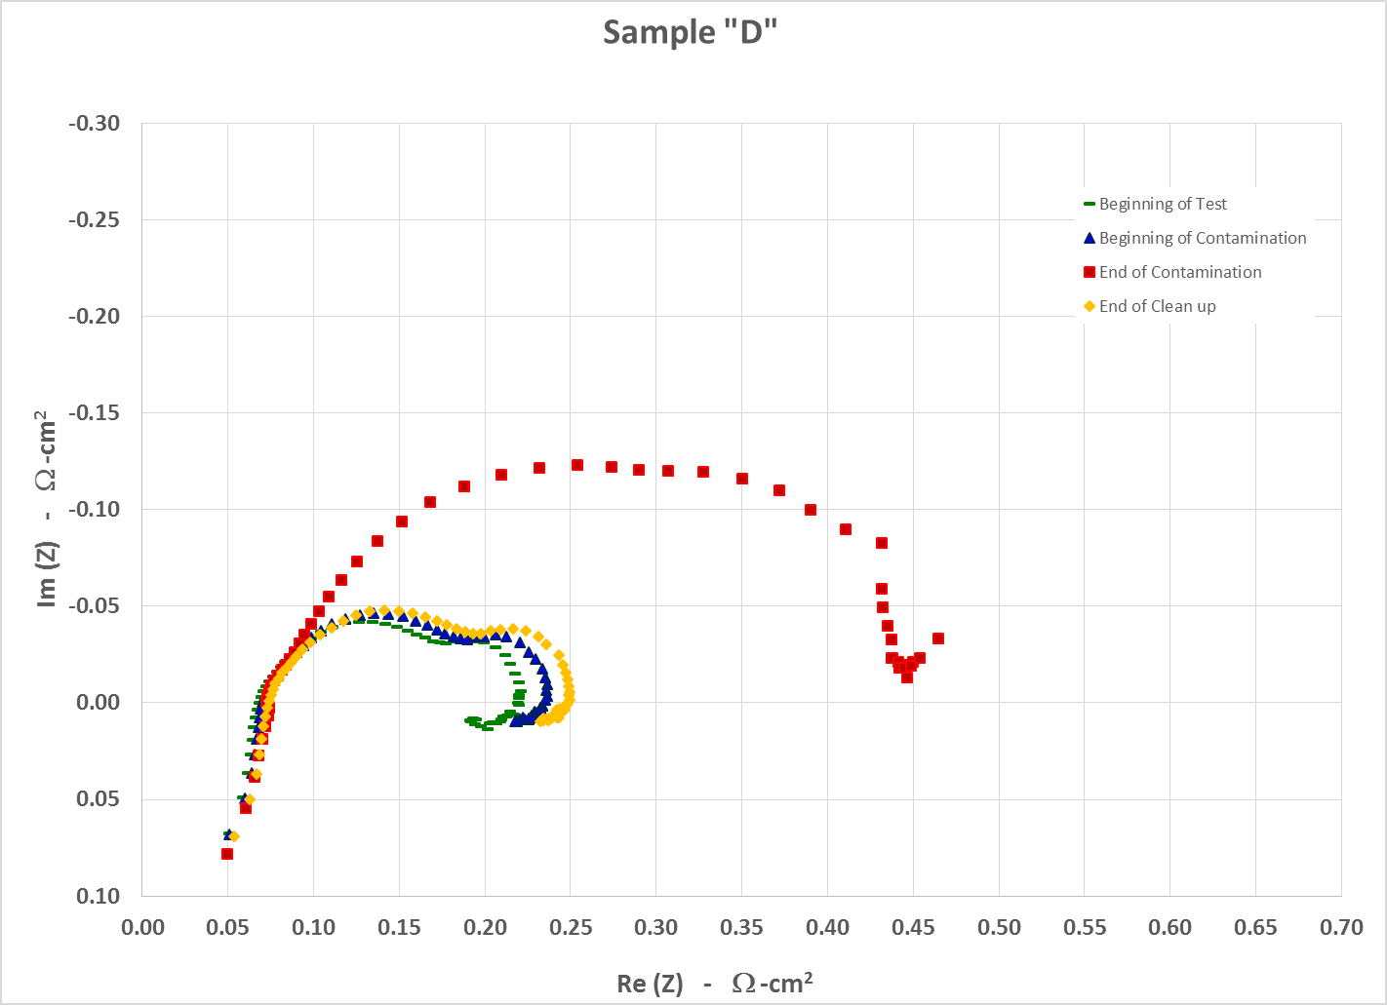
Results (cont)
Figure 5 – Electrochemical impedance spectroscopy (EIS)

Slide 14
Results (cont)
Test Results (cont):
The difference between the measurements at the beginning of the test and beginning of contamination are slight and may be due to saturation of the cathode GDL.
The difference between the measurements at the beginning of contamination and end of contamination are notable.
Frequency magnitude from right to left.
Right is 0.1 Hz and represents issues in mass transport issues
Left is 10 kHz and represents ionic and ohmic resistance
Looks to be mass transport issues.
The difference between the measurements at the end of contamination and end of test are also notable. They indicate at least a partial recovery.

Slide 15
What does this mean?
Assumptions:
Ingest 14 cc’s of 100% cleanser during a 7 kg fill
Operate at ~1/4 power (1000 mA/cm2) for 14 hrs (est. range on 7 kg)
Results:
Operating at extreme conditions
Assumptions may be too conservative
Decay is 0.2 mV/hr @1000 mA/cm2 prior to contamination
Decay is ~1275 mV/hr @1000 mA/cm2 during contamination
Clean up consisted of injecting DI water. Cell partially recovered
The EIS improved. This may indicates mass transport issues.

Slide 16
Retest
Cell was retested with a 0.5% concentration
Results:
Total exposure was ~5 times greater on the second test
Decay not as severe; ~ 2 mV/hr
No recovery
No improvement in IR or EIS.

Slide 17
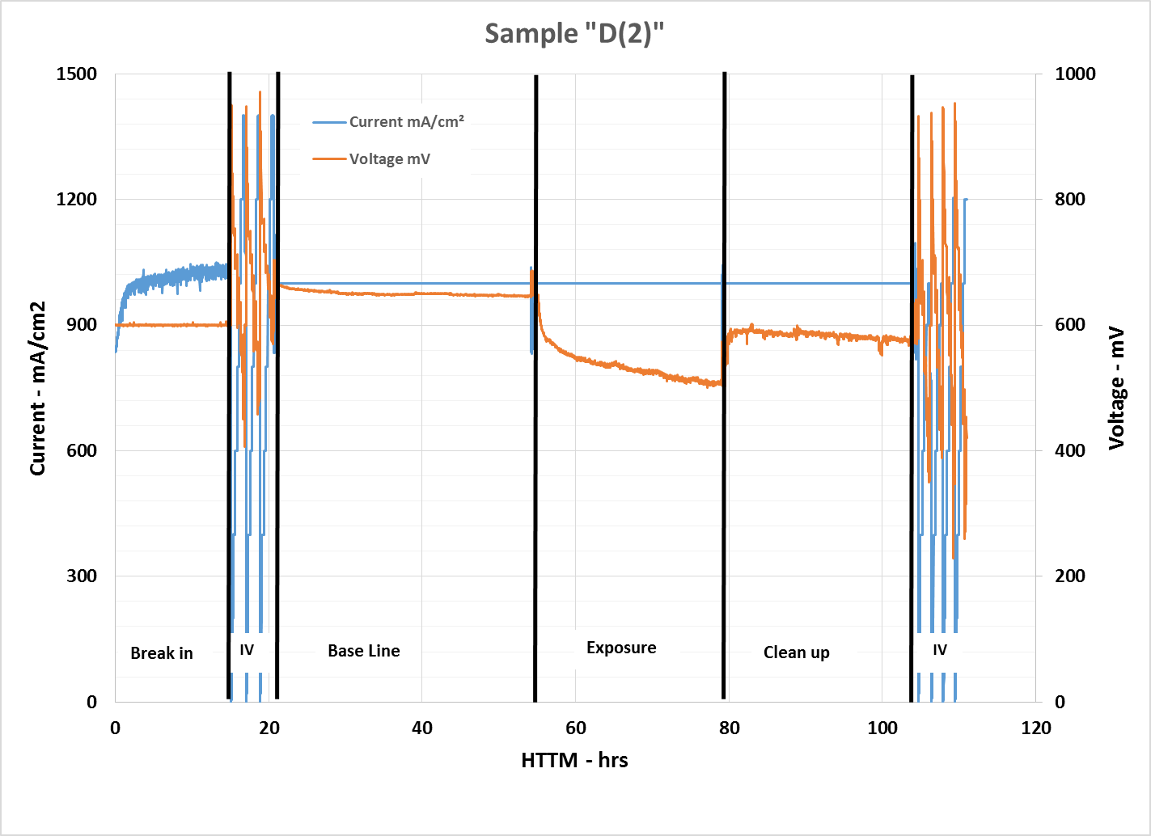
Results (cont)
Figure 6 – 2nd Cell History Plot

Slide 18
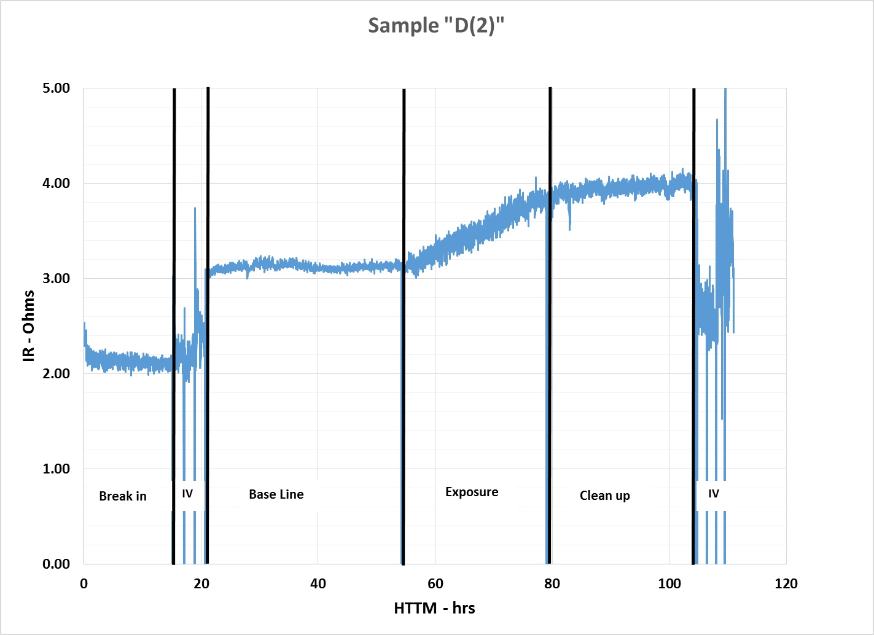
Results (cont)
Figure 7 – 2nd Cell IR plot

Slide 19
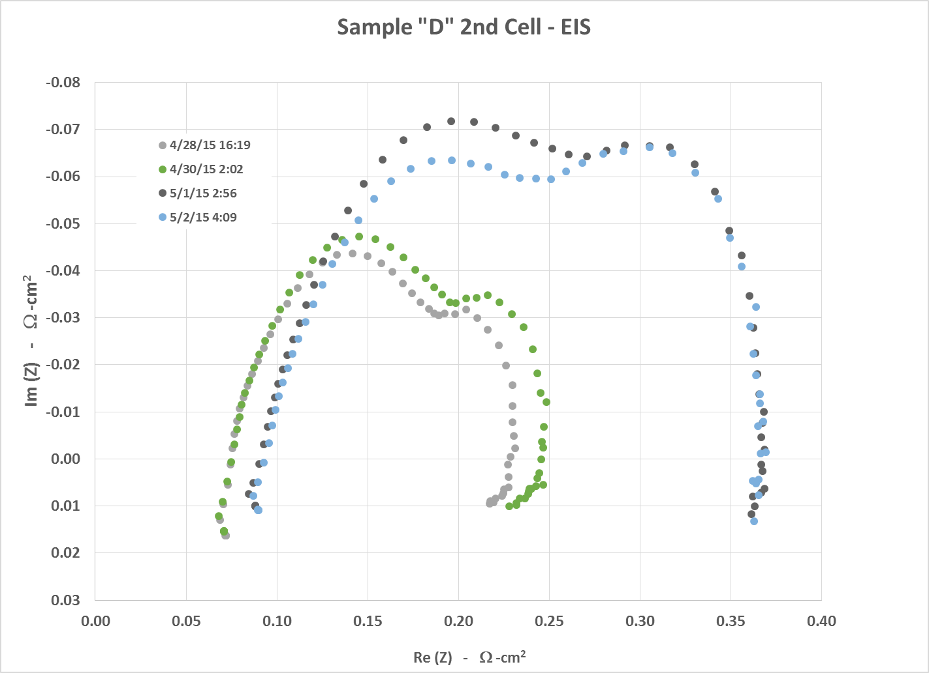
Results (cont)
Figure 8 – 2nd Cell EIS

