Slide 1
DoE Cleanser Screening Tests First Cleanser using ETDA, Tetrasodium (Trisodium Phosphate substitute) Preliminary
W. Collins
C2E2
2015 July 30

Slide 2
Objective
The objective of this screening test is to conduct a compatibility test between this compound and PEM fuel cells.
The testing is done in support of a supplement to a US DoE EERE contact, DE-EE0000467.
The results indicate some interaction between the compound and PEM fuel cells at the concentration and flow tested.

Slide 3
Test parameters
Cell
Size 25 cm²
Electrode Gore-50
Loadings 0.4/0.4 mgPt/cm²
Operation
Current Density 1000 mA/cm²
Cell Temperature 80⁰C
Inlet dew points
Anode 48⁰C
Cathode 87⁰C
Exit Pressures Ambient/Ambient

Slide 4
Test parameters (cont)
Conditions
Flows
Anode 1.75 lpm (10)
Cathode 1.55 lpm (4)
Atomizer 130e-06 lpm
(~200 ppm)
Operating Point
Intentionally close to flooding
(worst case)
Program
Break in 23 hr hold @600 mV Diagnostics 4 hrs
Baseline 44 hr hold @1000 mA/cm2 Diagnostics 1 hr
Contamination 24 hr hold @1000 mA/cm2
Diagnostics 1 hr
Clean up 25 hr hold @1000 mA/cm2 Diagnostics 4 hrs
Total 126 hrs

Slide 5
Compound
Concentration 5% of full strength
(estimate after two rinses)
Composition MSDS
First product tested.
Component | CAS# | % by wt.
ETDA, Tetrasodium (38%) | 64-02-8 | 0 – 5%
Sodium Metasilicate | 6834-92-0 | 0 – 5%

Slide 6
Results
Summary of Testing
Break in and initial diagnostics normal
Baseline normal
Diagnostics after baseline normal
Decay during contamination ~95 mV in 24 hrs.
Diagnostics after contamination abnormal
No useable recovery
Diagnostics after clean up show additional degradation

Slide 7
Results (cont)
Test Results of cell Sample E:
Figure 1 shows the performance history.
Figure 2 shows changes in IR during contamination.
Figure 3A (anode) and Figure 3C (cathode) show no decay due to crossover.
Figure 4A (anode) and Figure 4C (cathode) show no catalyst issues
The Electrochemical impedance spectroscopy (EIS) shown in Figure 5 is conforms with the IR measurements

Slide 8
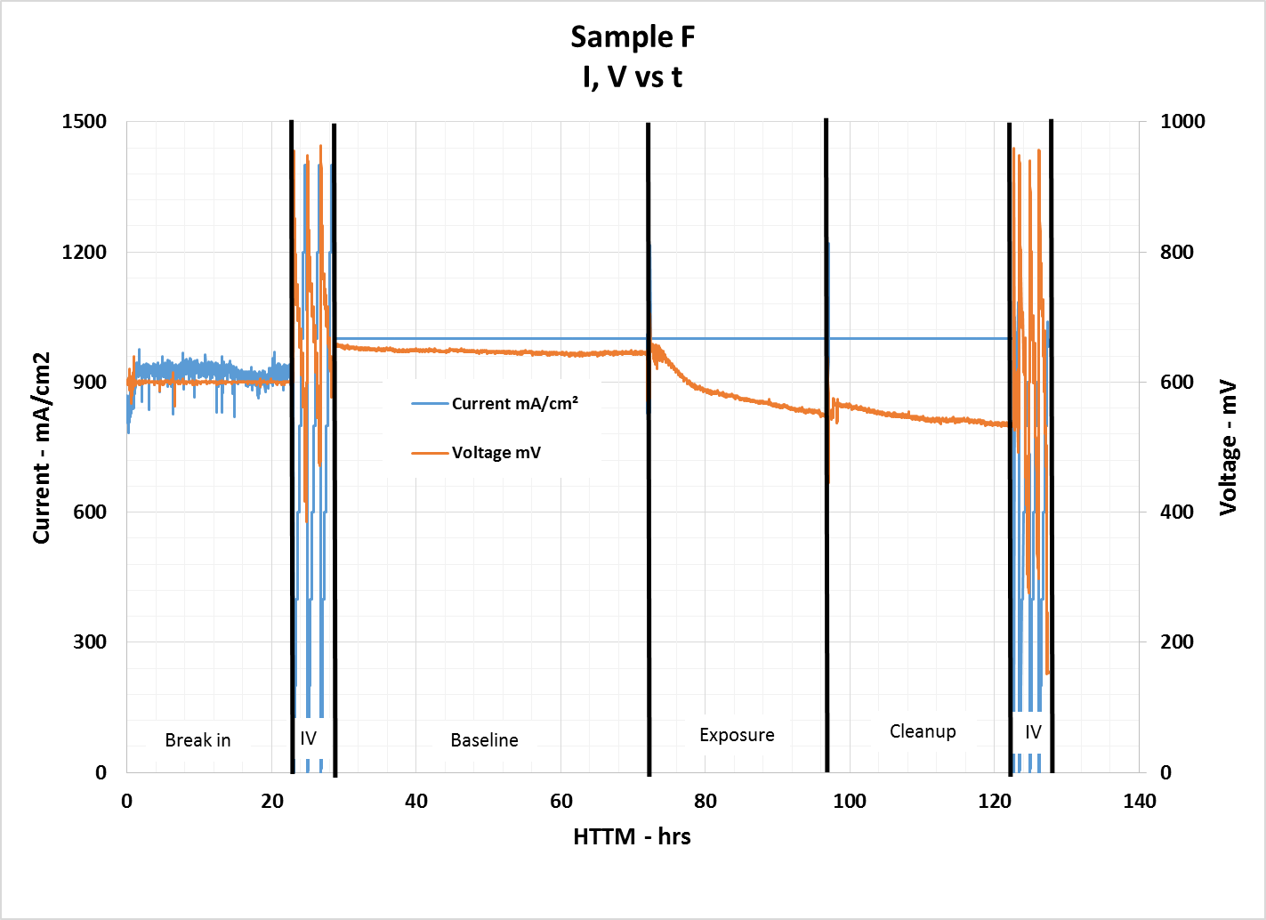
Results (cont)
Figure 1 – Performance History
Decay starts upon exposure.
Not recoverable

Slide 9
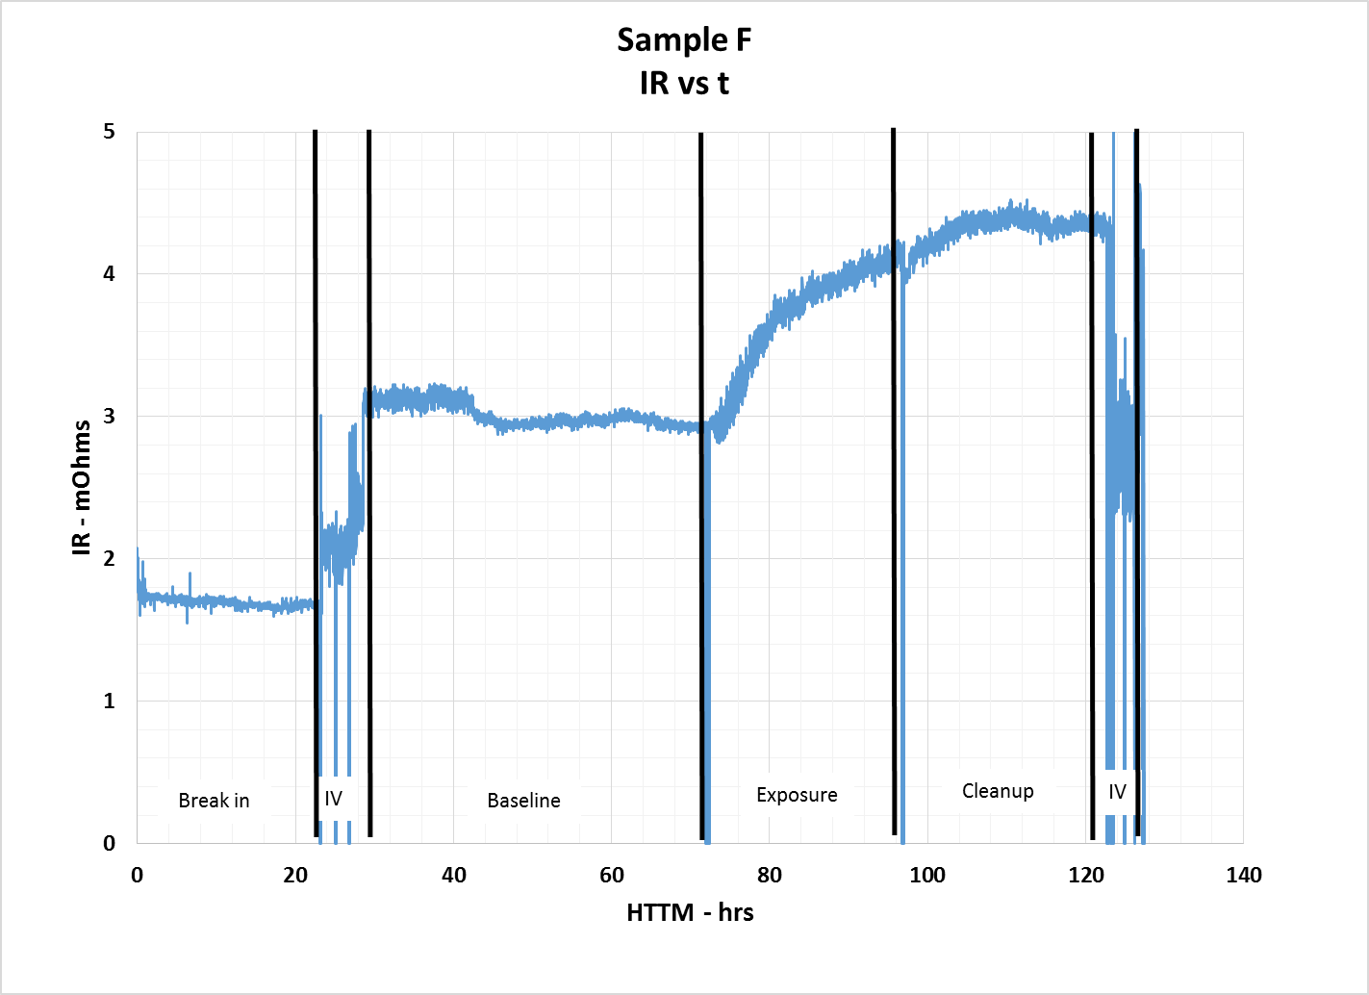
Results (cont)
Figure 2 – IR History
Increase during exposure.
Continues to increase during clean up

Slide 10
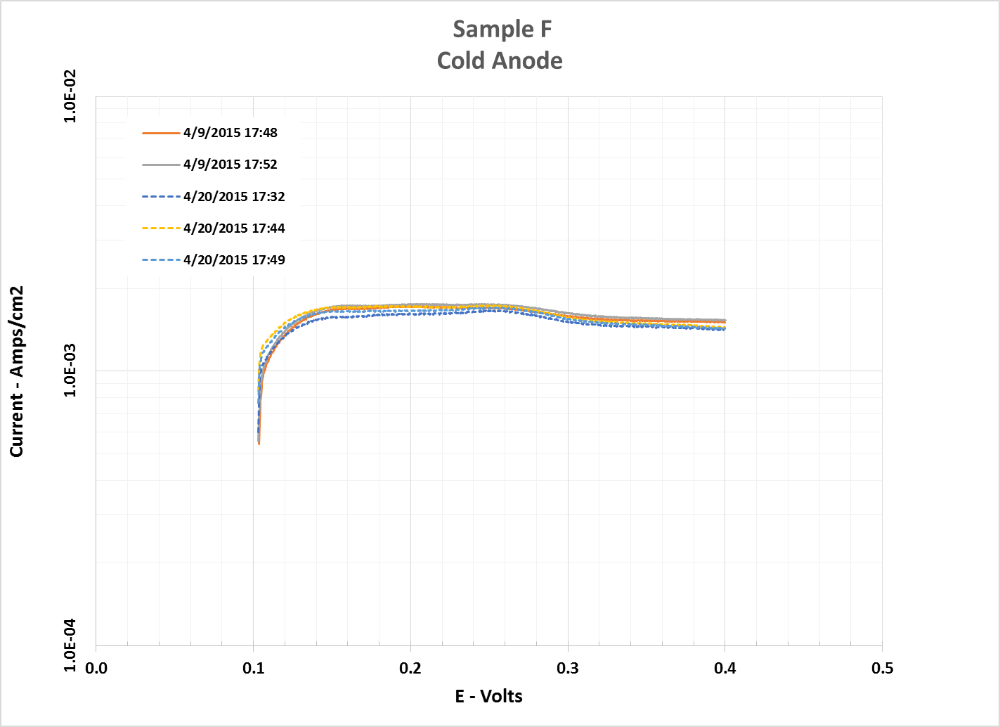
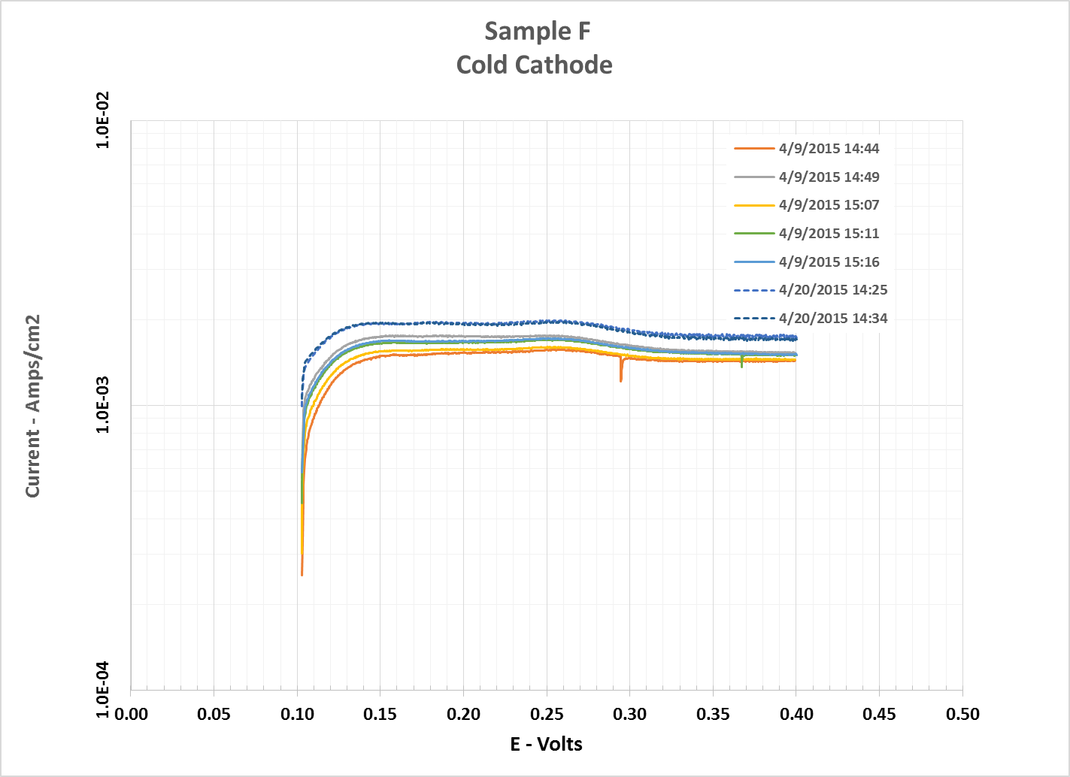
Results (cont)
Figure 3 – X/O History
Beginning of Test and End of Test data basically the same.

Slide 11
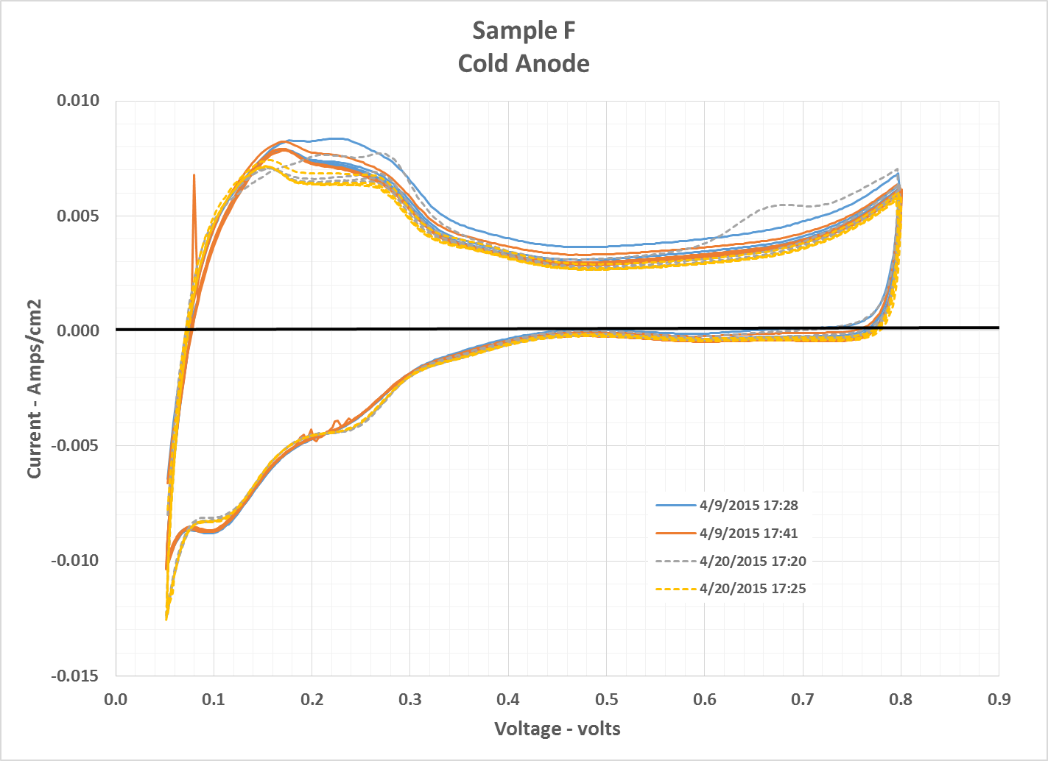
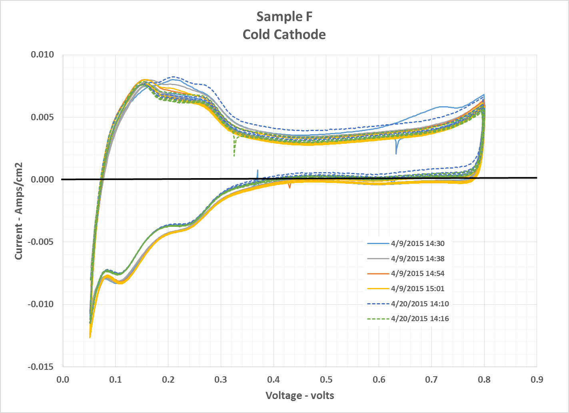
Results (cont)
Figure 4 – Cyclic Voltammetry History
Beginning of Test and End of Test are as expected.

Slide 12
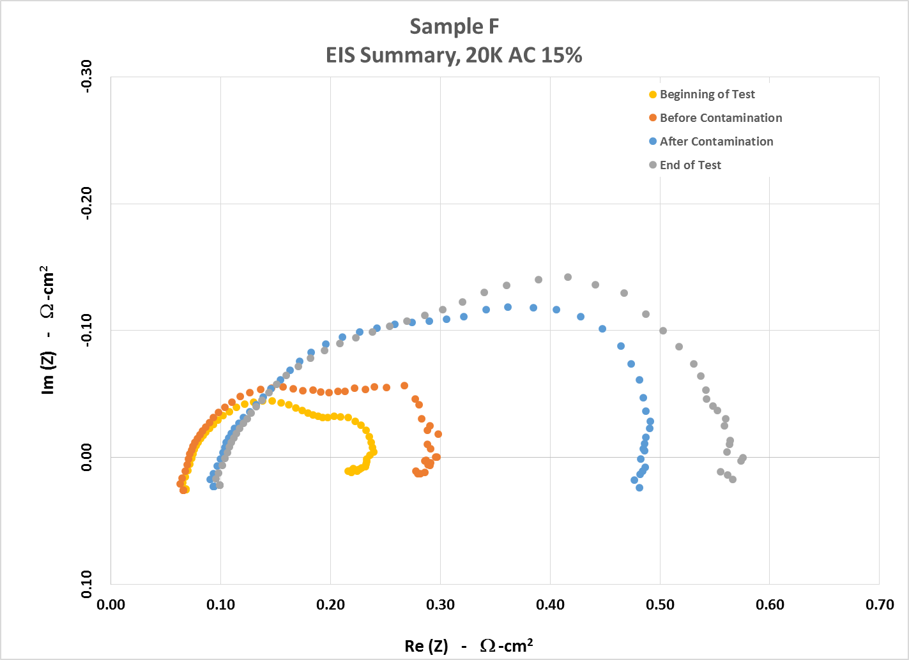
Results (cont)
Figure 5 – Electrochemical impedance spectroscopy (EIS)

Slide 13
Results (cont)
Test Results (cont):
The difference between the measurements at the beginning of the test and beginning of contamination are slight and may be due to saturation of the cathode GDL.
The difference between the measurements at the beginning of contamination and end of contamination are notable.
Frequency magnitude from right to left.
Right is 0.1 Hz and represents issues in mass transport issues
Left is 10 kHz and represents ionic and ohmic resistance
Looks to be mass transport issues.
There was no recovery.

