Slide 1
DoE Cleanser Screening Tests First Cleanser using pNaphtha Preliminary
W. Collins
C2E2
2015 October 19

Slide 2
Objective
The objective of this screening test is to conduct a compatibility test between this compound and PEM fuel cells.
The testing is done in support of a supplement to a US DoE EERE contact, DE-EE0000467.
The results indicate some interaction between the compound and PEM fuel cells at the concentration and flow tested.

Slide 3
Test parameters
Cell
Size 25 cm²
Electrode Gore-50
Loadings 0.4/0.4 mgPt/cm²
Operation
Current Density 1000 mA/cm²
Cell Temperature 80⁰C
Inlet dew points
Anode 48⁰C
Cathode 87⁰C
Exit Pressures Ambient/Ambient
Conditions
Flows
Anode 1.75 lpm (10)
Cathode 1.55 lpm (4)
Atomizer 10, 50 & 250e-06 lpm

Slide 4
Test parameters (cont)
Operating Point
Intentionally close to flooding (worst case)
Program
Break in
Diagnostics
Baseline, Diagnostics, 10 ul/min Contamination
Diagnostics, 150 ul/min Contamination, Clean up
Diagnostics, 1st 250 ul/min Contamination, Clean up Diagnostics, 2nd 250 ul/min Contamination, Clean up Diagnostics
Total 294 hrs

Slide 5
Compound
Concentration 0.2%, 1%, 4% _{vol dry}
Composition MSDS
CAS No. | Composition | % by Wt
68606-08-7 | Naphtha (petroleum) arom.-contg.* | 100
The above listed CAS number and product is comprised of the following components:
mixture | Paraffins (C4-C12, total) | 60-70
 | Naphthenes (C7-C10) total) | 7-12
 | Aromatics (Totals)** | 8-10
Additional Information
* | May be considered to be somewhat similar to Gasoline Blend Product (CSA #8006-61-9)
** | Aromatic compounds include toluene (1-3% - CAS # 108-88-3), mixed xylenes (1-3% -CAS # 1330-20-7), benzene (<2% - CAS # 71-43-2), ethylbenzene (<1% - CAS # 100-41-4), and naphthalene (<0.2% - CAS # 91-20-3).

Slide 6
Results
Summary of Testing
Exposed to 0.2% _{dry vol}
~0 mV step change
Decay same as baseline in 22 hrs.
Exposed to 1% _{dry vol}
~100 mV step change
No decay same in 24 hrs.
Exposed to 4% _{dry vol} saturated @89C for baseline & clean up
~150 mV step change
No decay same in 24 hrs.
Exposed to 4% _{dry vol}
~240 mV step change
No decay same in 24 hrs
Appears to have full recovery

Slide 7
Results (cont)
Test Results of cell Sample G:
Figure 1 shows the performance history.
Figure 2 shows changes in IR during contamination.
Figure 3A (anode) and Figure 3C (cathode) show no decay due to crossover.
Figure 4A (anode) and Figure 4C (cathode) show no catalyst issues
The Electrochemical impedance spectroscopy (EIS) shown in Figure 5 is conforms with the IR measurements

Slide 8
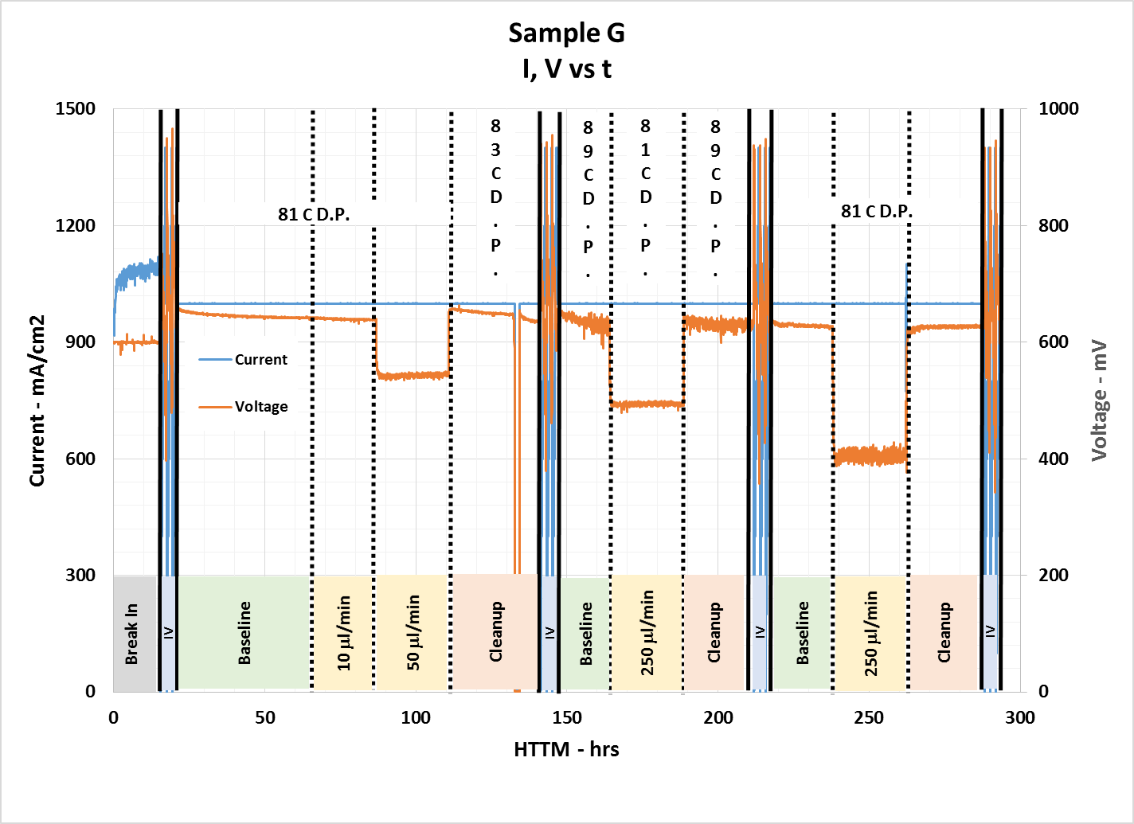
Results (cont)
Figure 1 – Performance History
5 mV - 0.2%, 100 mV – 1%, 150 mV -1st 4%, 240 mV -2nd 4%.
Recoverable

Slide 9
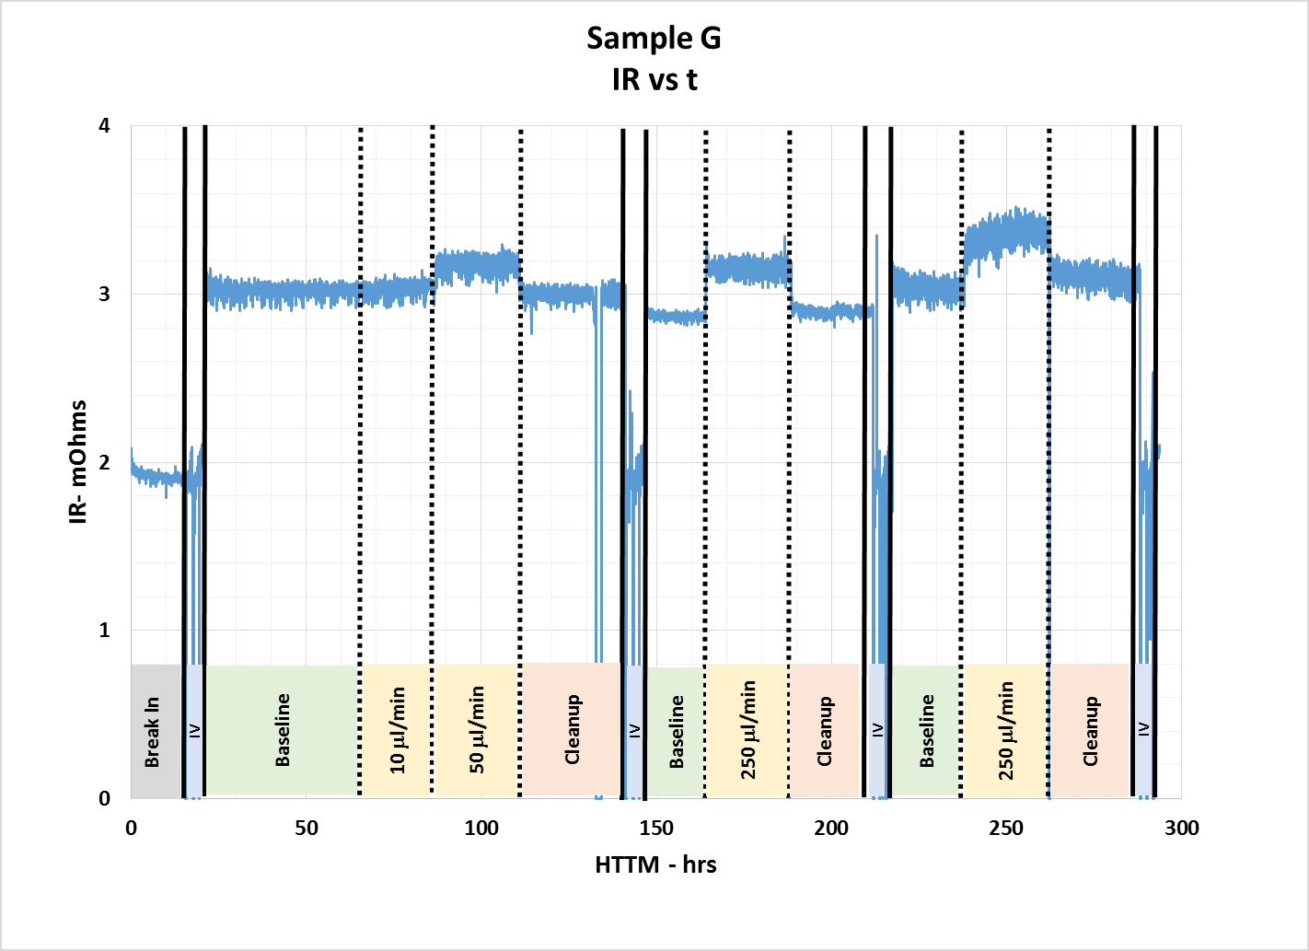
Results (cont)
Figure 2 – IR History
Tracks with performance

Slide 10
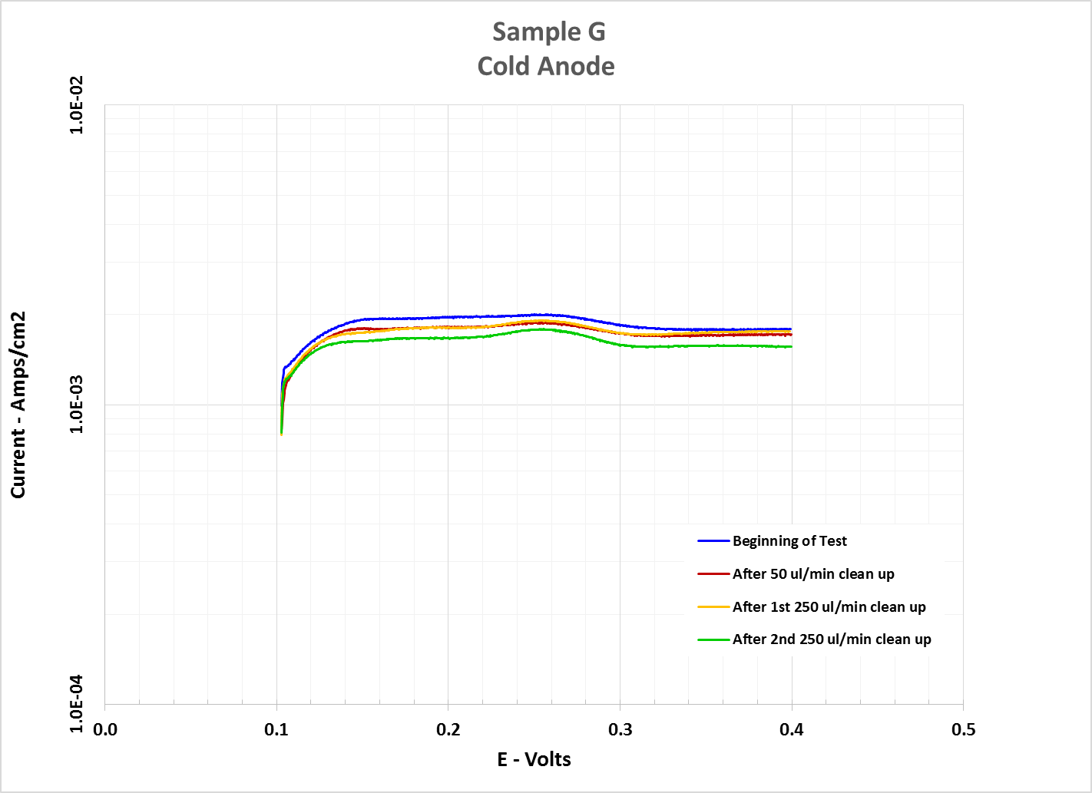
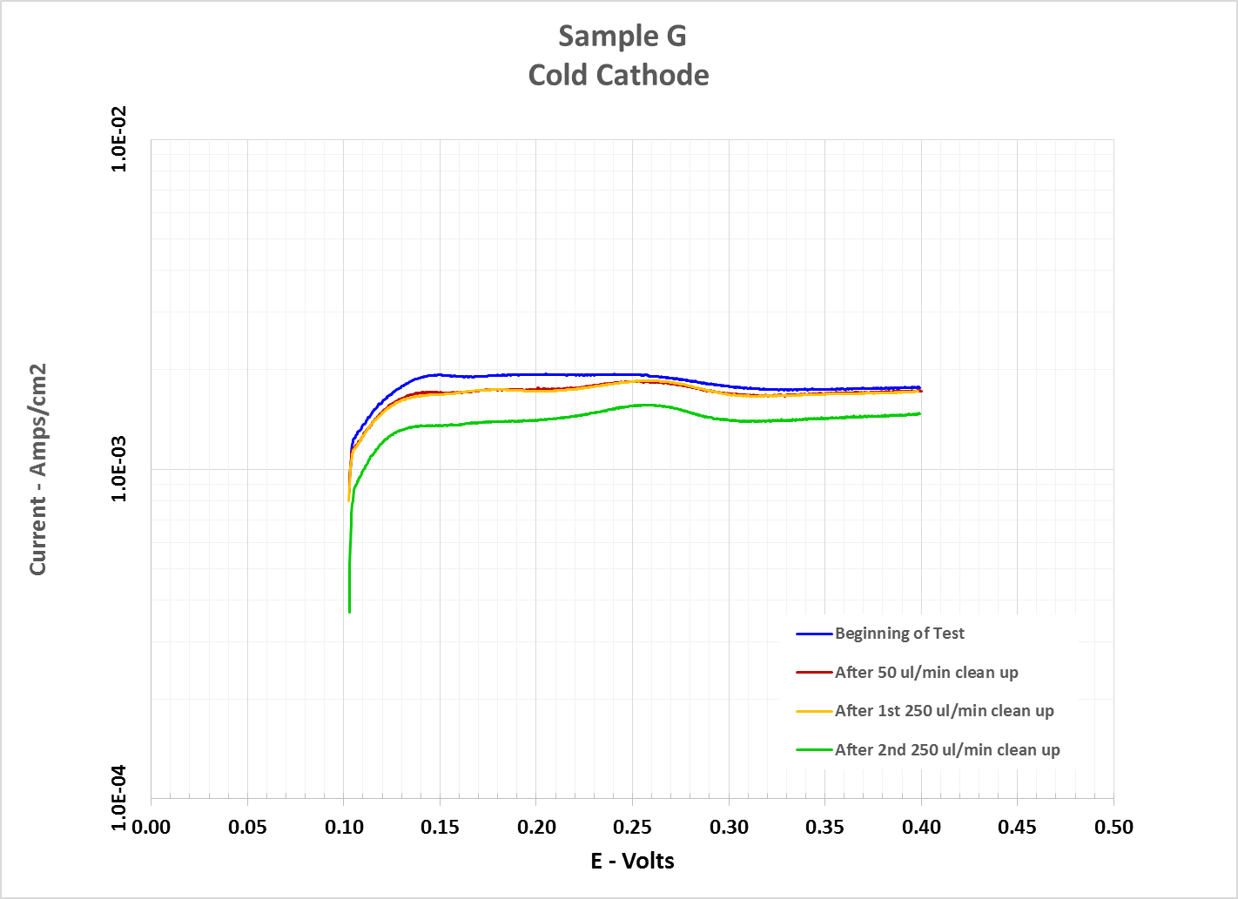
Results (cont)
Figure 3 – X/O History
Beginning of Test and End of Test data basically the same. Slight improvement with time

Slide 11
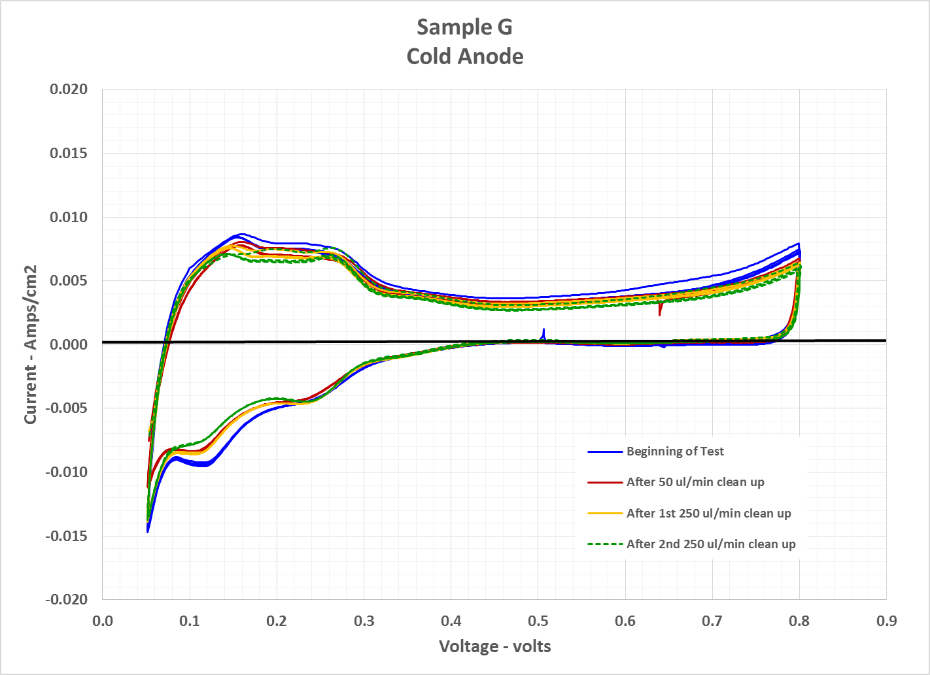
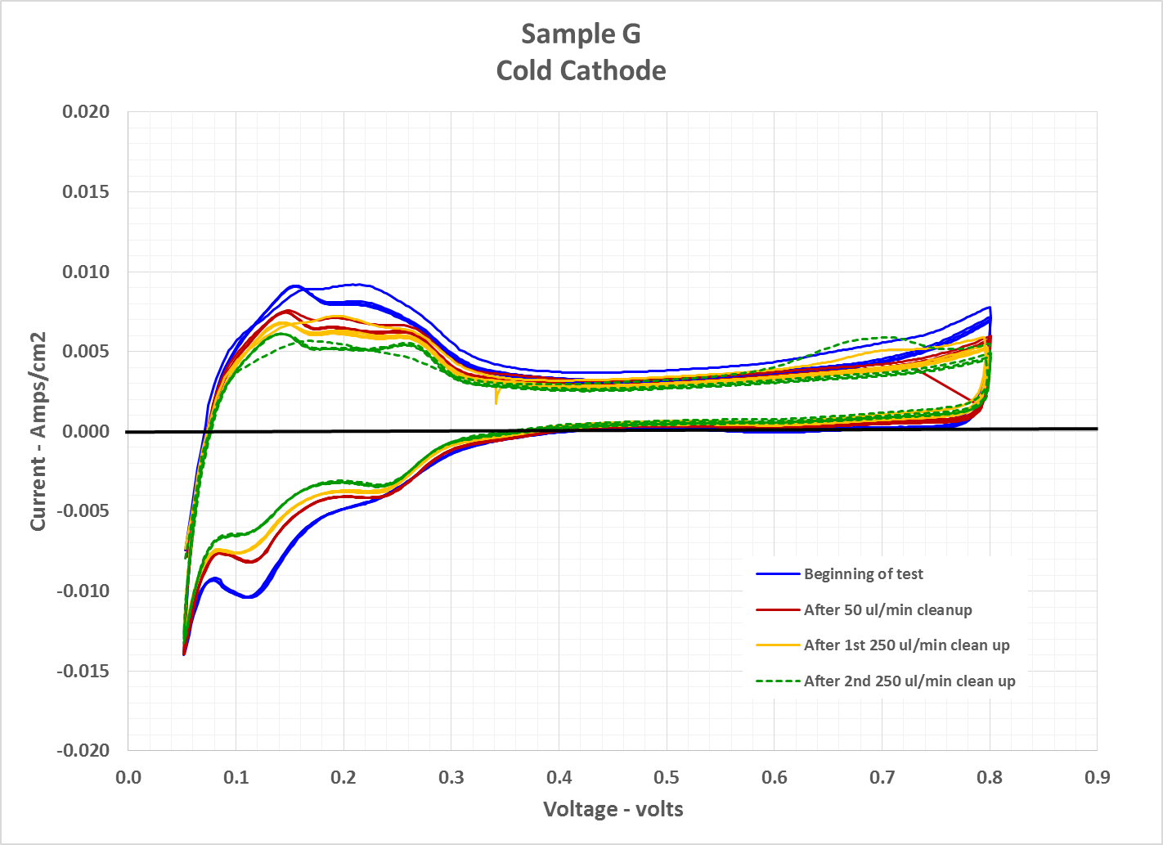
Results (cont)
Figure 4 – Cyclic Voltammetry History
No surprises here

Slide 12
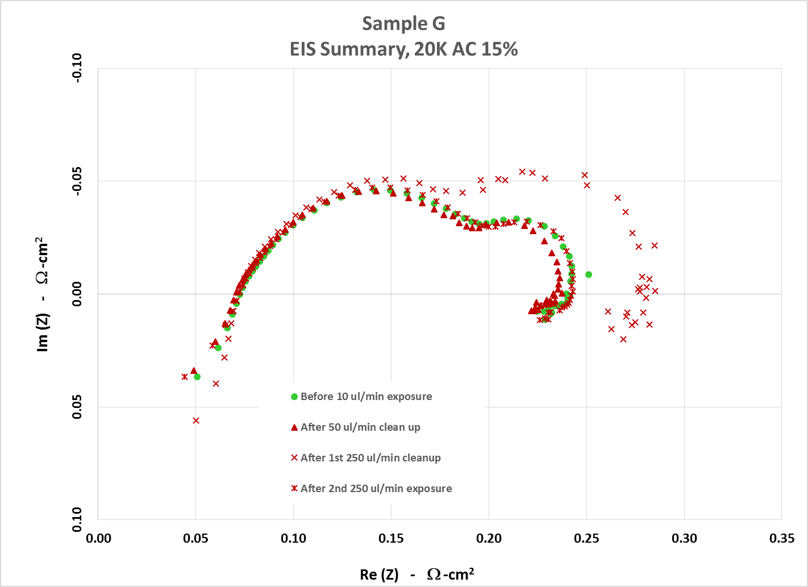
Results (cont)
Figure 5 – Electrochemical impedance spectroscopy (EIS)
1st 4% clean up not long enough, 2nd was ~50% longer and recovered

