Slide 1
DoE Cleanser Screening Tests First Cleanser using Isopropanol Preliminary
W. Collins
C2E2
2015 October 19

Slide 2
Objective
The objective of this screening test is to conduct a compatibility test between this compound and PEM fuel cells.
The testing is done in support of a supplement to a US DoE EERE contact, DE-EE0000467.
The results indicate some interaction between the compound and PEM fuel cells at the concentration and flow tested.

Slide 3
Test parameters
Cell
Size 25 cm²
Electrode Gore-50
Loadings 0.4/0.4 mgPt/cm²
Operation
Current Density 1000 mA/cm²
Cell Temperature 80⁰C
Inlet dew points
Anode 48⁰C
Cathode 87⁰C
Exit Pressures Ambient/Ambient

Slide 4
Test parameters (cont)
Conditions
Flows
Anode 1.75 lpm (10)
Cathode 1.55 lpm (4)
Atomizer 10e-06 lpm
Operating Point
Intentionally close to flooding (worst case)
Program
Break in 16 hr hold @600 mV Diagnostics 5 hrs
Baseline 52 hr hold @1000 mA/cm2 Diagnostics 1 hr
Contamination
0.2% vol dry 26 hr hold @1000 mA/cm2
Diagnostics 1 hr
Clean up 19 hr hold @1000 mA/cm2
Total 120 hrs

Slide 5
Compound
Concentration 0.2% vol _{dry gas}
(estimate after two rinses)
Composition Reagent Grade Isopropanol

Slide 6
Results
Summary of Testing
Break in and initial diagnostics normal
Baseline normal
Diagnostics after baseline normal
Exposed to 0.2% _{vol dry gas}
70 mVchange
0.3 mV/ hr decay (typical).
Appears to have partial recovery

Slide 7
Results (cont)
Test Results of cell Sample G:
Figure 1 shows the performance history.
Figure 2 shows changes in IR during contamination.
Figure 3A (anode) and Figure 3C (cathode) show no decay due to crossover.
Figure 4A (anode) and Figure 4C (cathode) show no catalyst issues
The Electrochemical impedance spectroscopy (EIS) shown in Figure 5 is conforms with the IR measurements

Slide 8
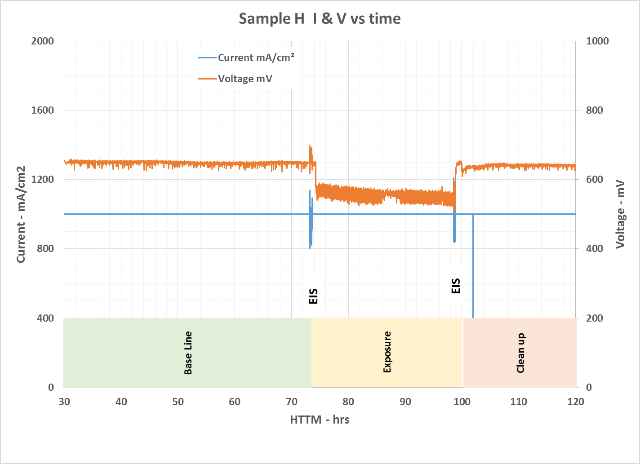
Results (cont)
Figure 1 – Performance History

Slide 9
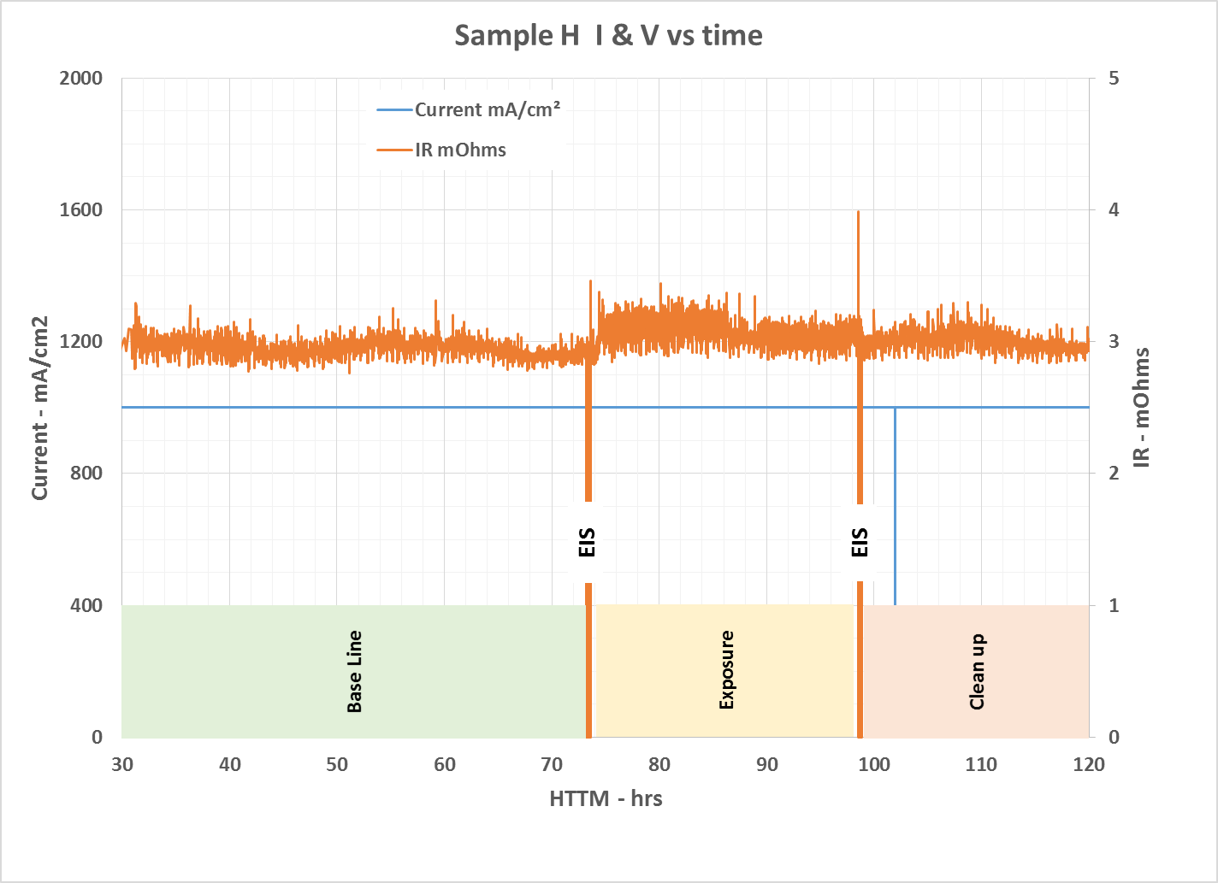
Results (cont)
Figure 2 – IR History

Slide 10
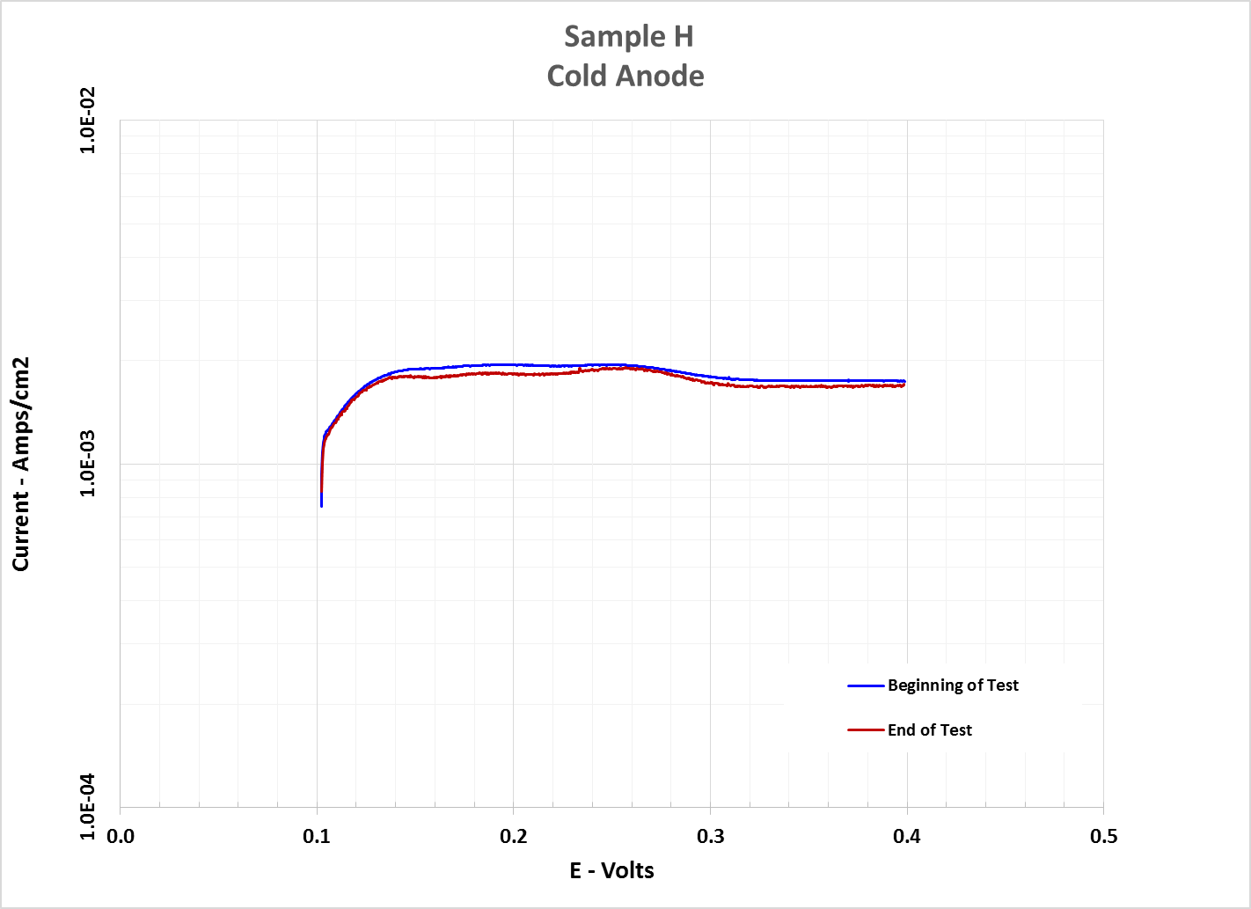
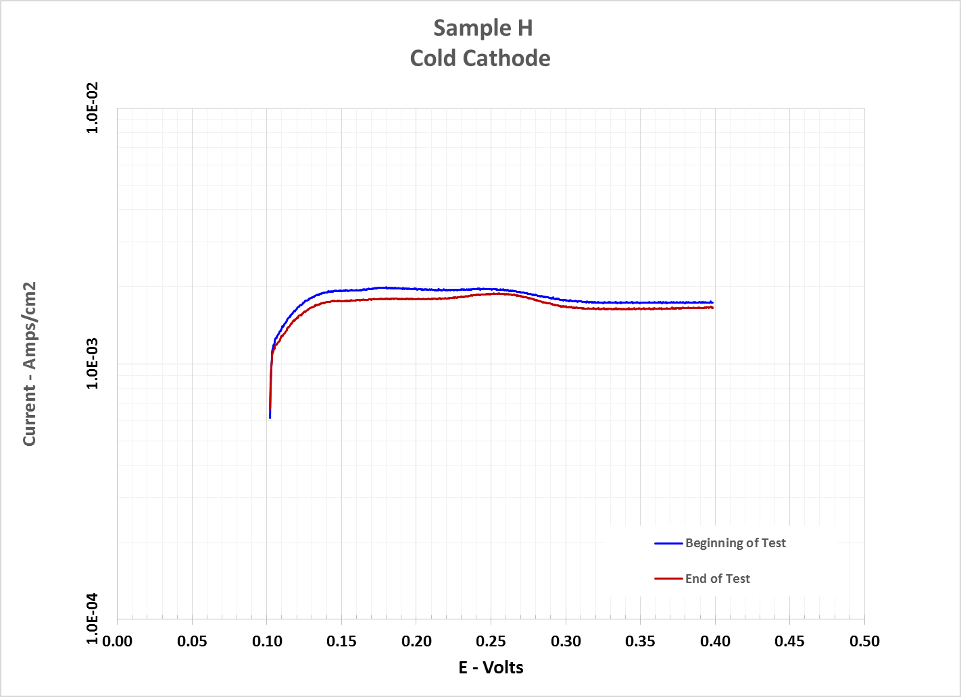
Results (cont)
Figure 3 – X/O History
Beginning of Test and End of Test data basically the same.

Slide 11
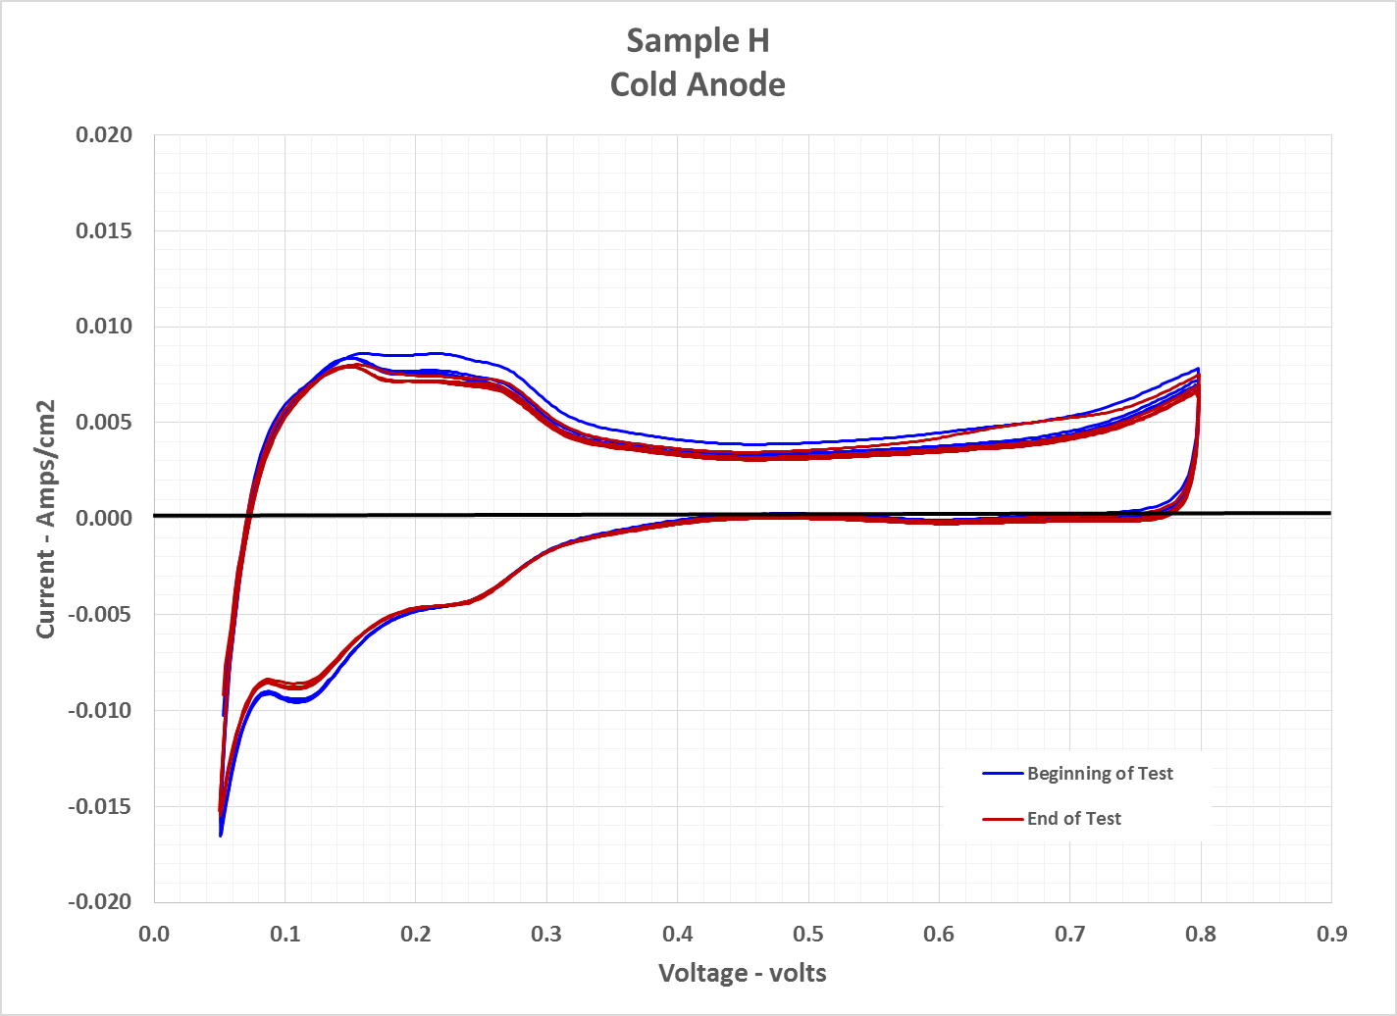
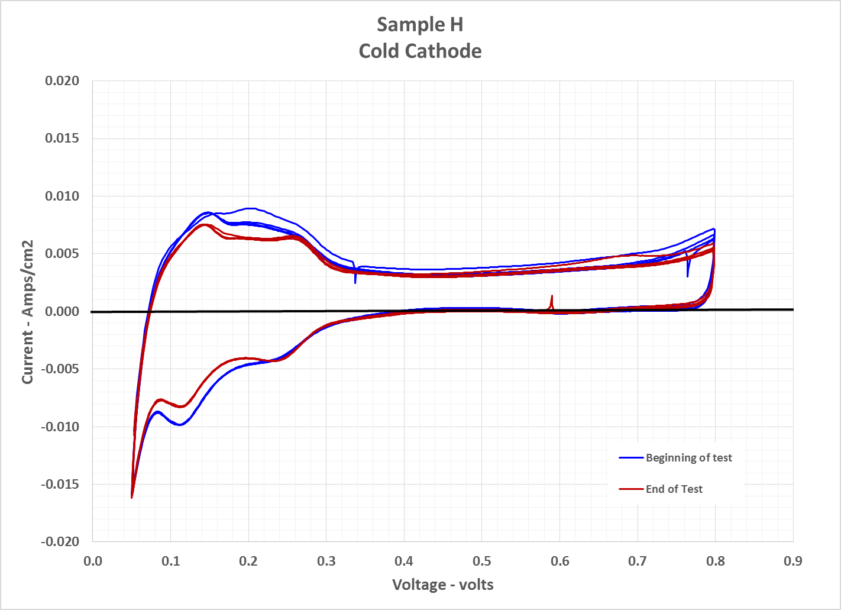
Results (cont)
Figure 4 – Cyclic Voltammetry History

Slide 12
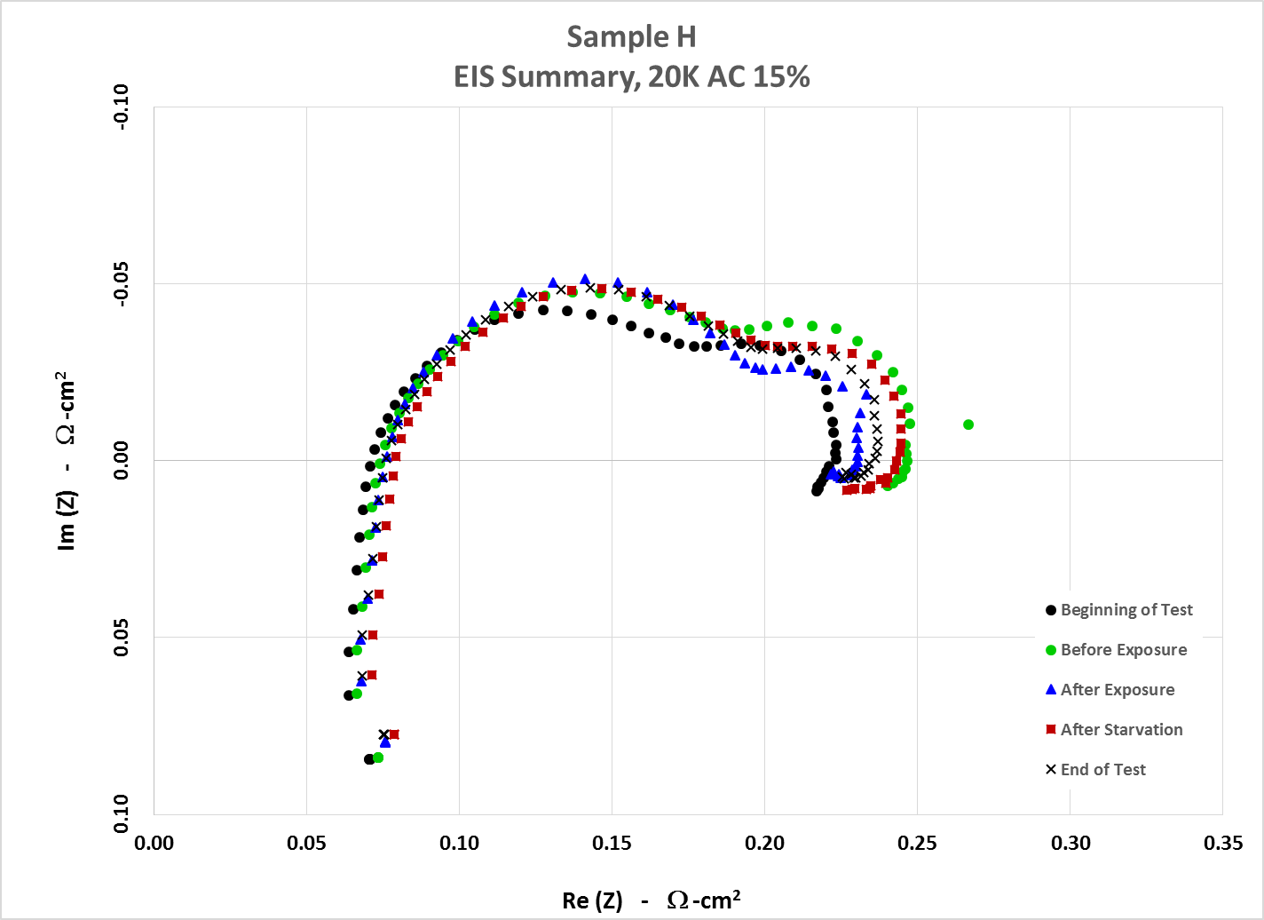
Results (cont)
Figure 5 – Electrochemical impedance spectroscopy (EIS)

